Slide 1
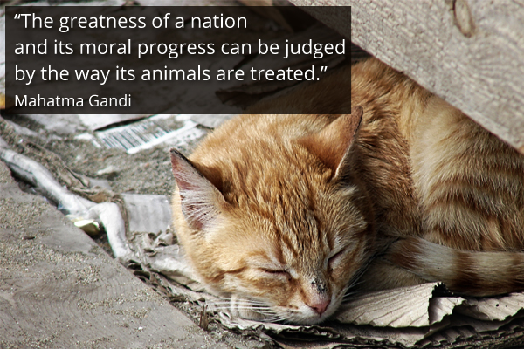
My hobby
An interview with teacher Lidija Miklošević
By Nera Bandić

Slide 2
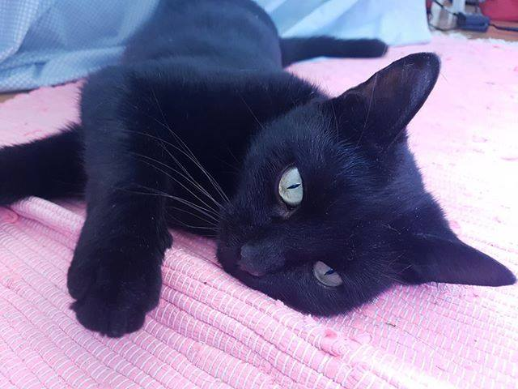
1.Why did you decide to rescue specifically cats?
I guess because I was raised around cats. My grandparents always had cats and my sister and I used to play with them a lot.

Slide 3
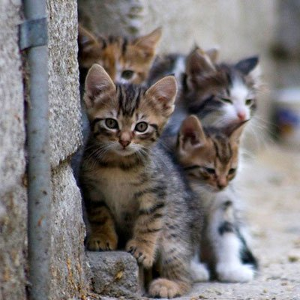
2. How many cats have you rescued so far?
I don’t know exactly. I’ve helped maybe 30 cats in three years time.

Slide 4
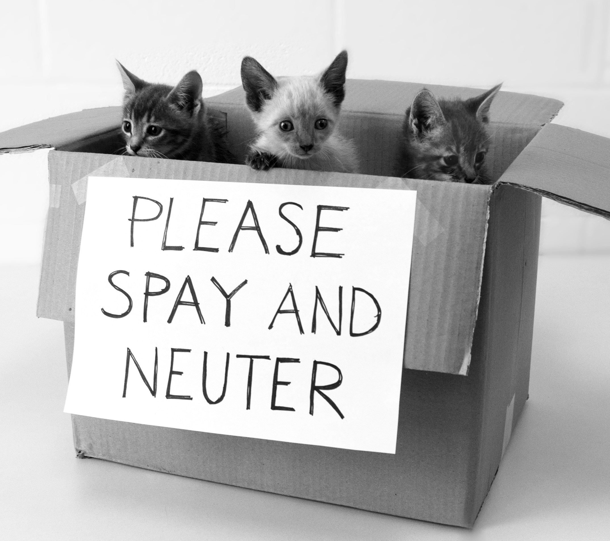
3.Does anyone help you?
Yes, I’m volunteering in one of the associations for animal protection called Full Litter Box. We mostly work on spaying/neutering stray cats. We also drive ill cats to the vet, look for foster and forever homes, provide health care…

Slide 5
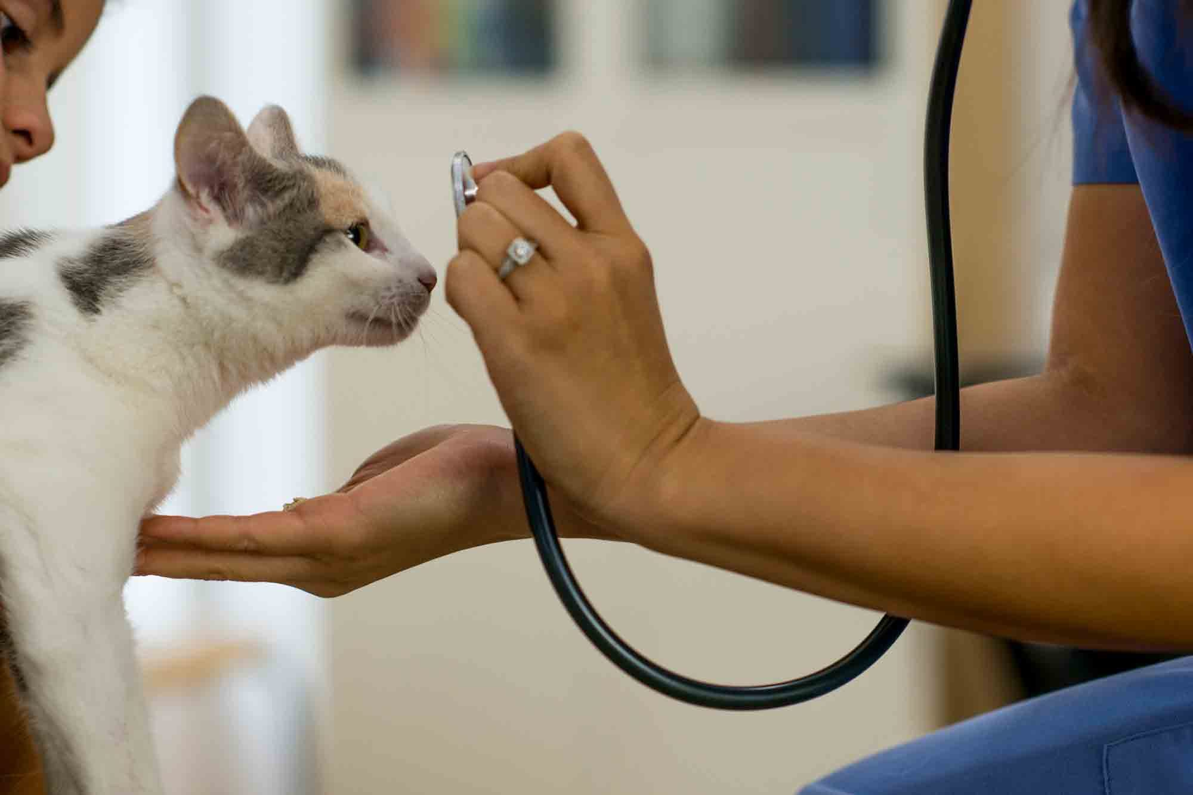
4.In what way do you rescue them?
Some of them just need transport to the vet, some need health care and some need a foster home for a while. Right now, I’m fostering a cute kitten. First I took her to the vet. Then I gave her the antibiotics that the vet prescribed. Finally I took her for a check up. And that’s how things usually happen ☺.

Slide 6
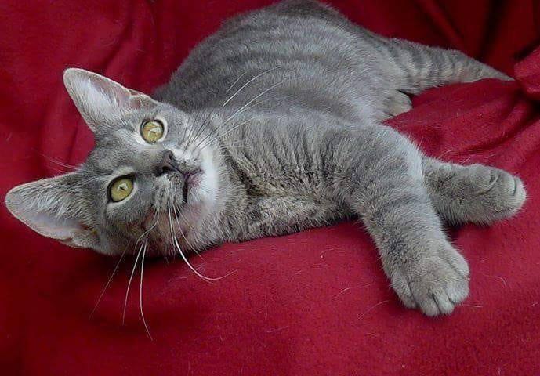
5.Where do you put all these cats?
We put them in foster families. Or if they are injured, they stay in a veterinary station for a while.

Slide 7

6.How do you find cat foster families?
We ask the citizens to take in a cat for fostering if they can. The association provides for everything else: the food and all the expenses.

Slide 8
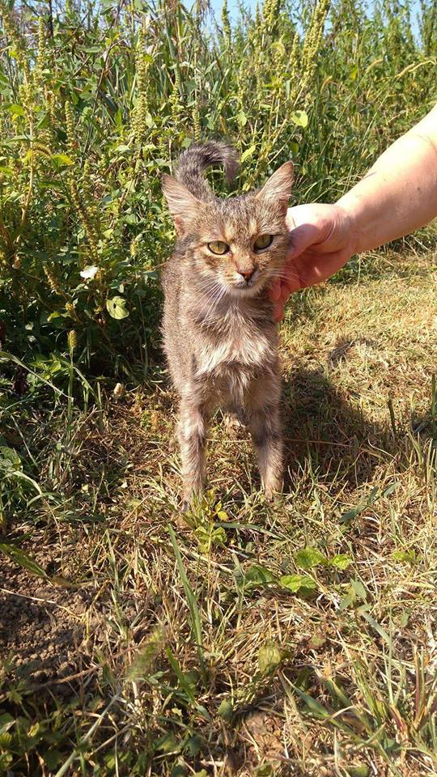
7. What do you do if a cat is sick?
I take her to the vet, of course. In most cases the cat just needs antibiotics and she is as good as new ☺

Slide 9
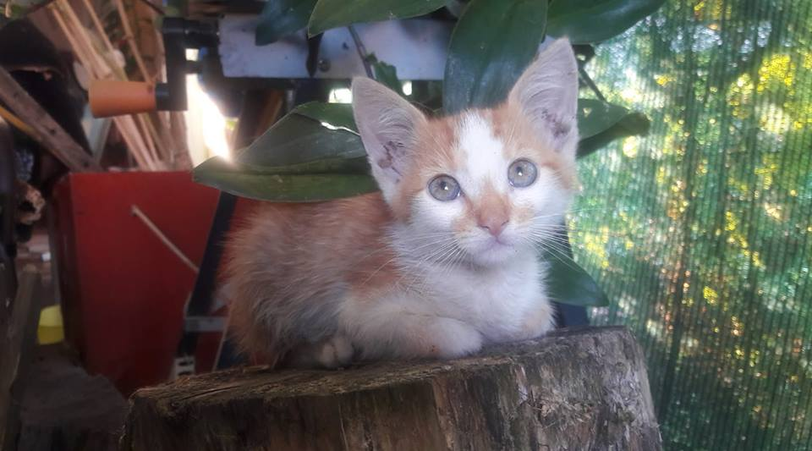
8. Do you have your favourite cat?
No, I like all of them.

Slide 10
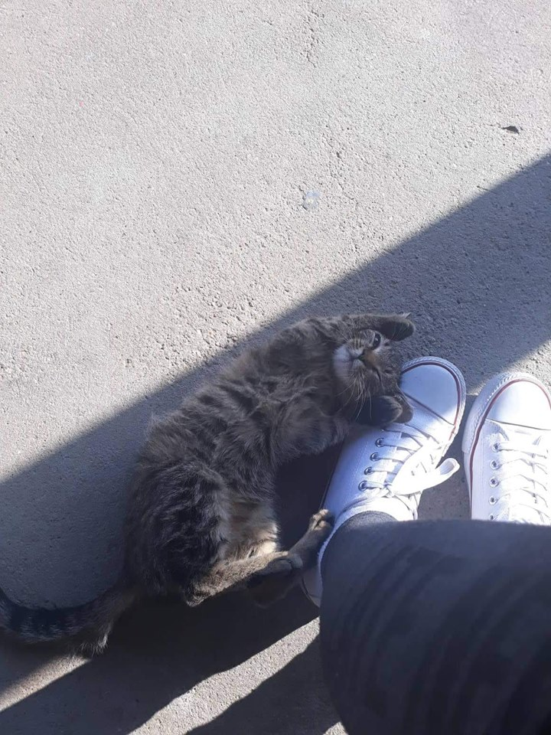
9.Do you give names to all rescued cats?
They all have names. These are the names that come to my mind right now: Jelena, Elena, Đumbir, Bosiljak, Garfield, Mona, Iris, Molly…

