Slide 1
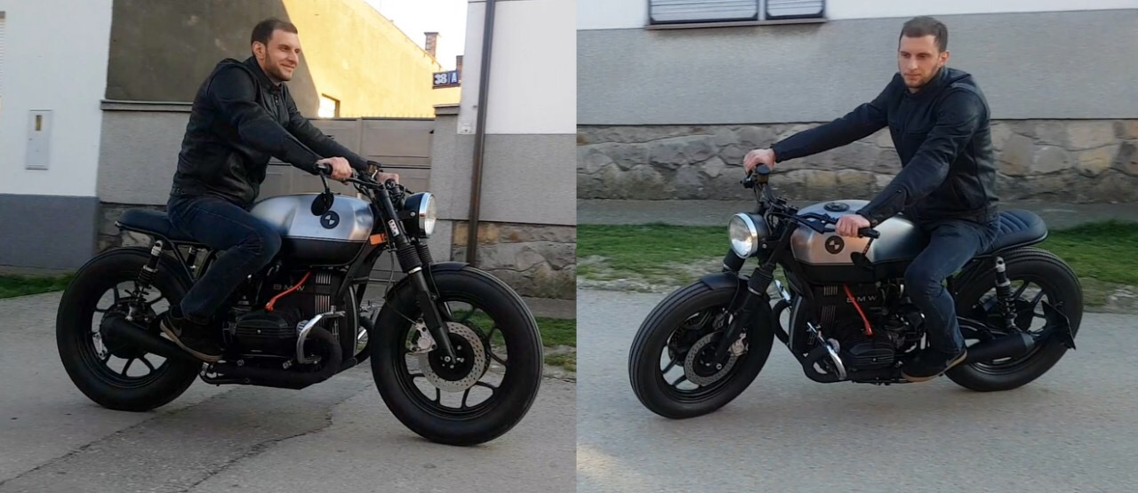
MY TEACHER´S HOBBY

Slide 2
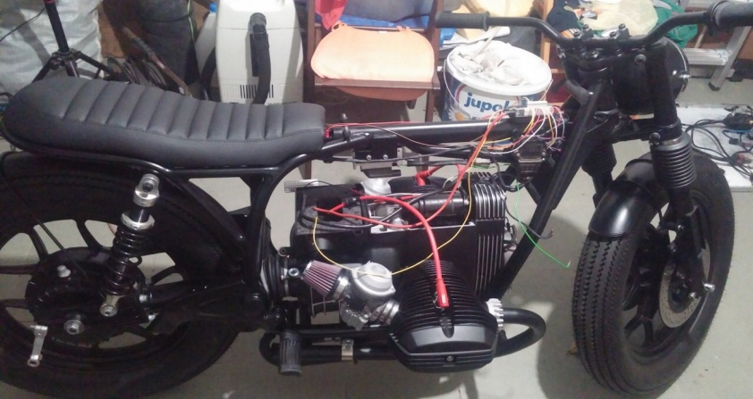
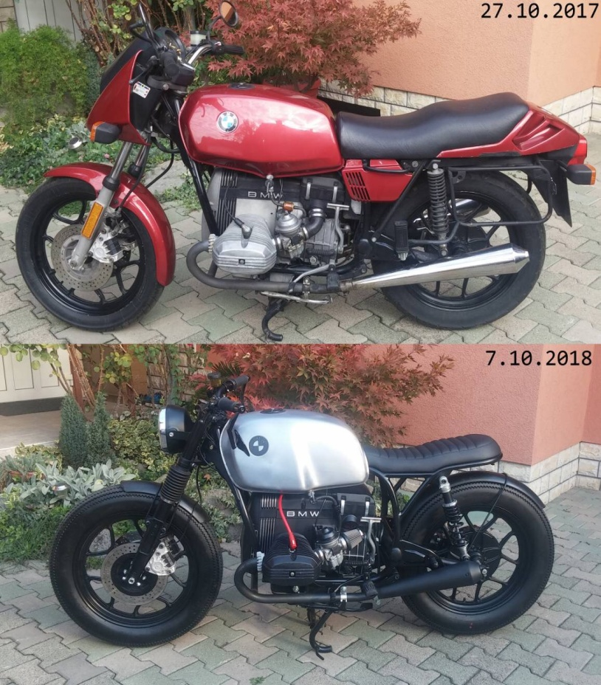
MY TEACHER’S HOBBY
1.QUESTION:What is your hobby?
ANSWER:There are a lot of things that I like to do, but one of my recent hobbies is rearrange of old motorcycles and driving them,

Slide 3
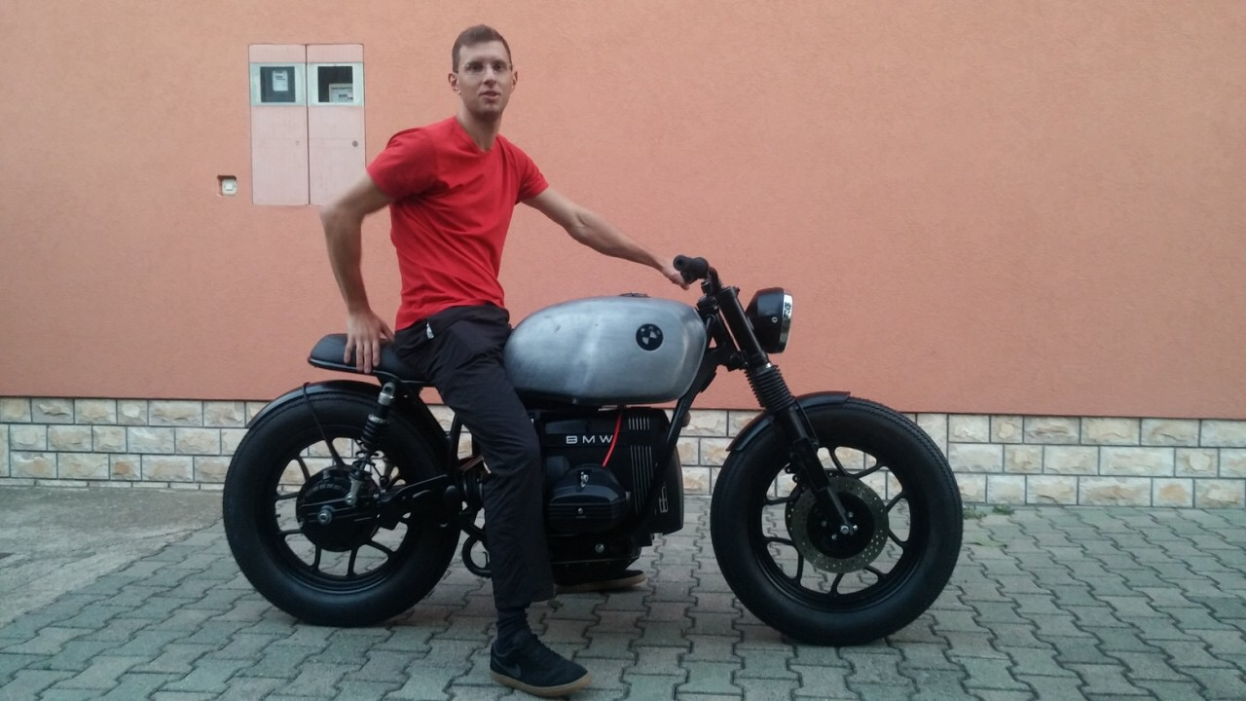
MY TEACHER’S HOBBY
2.QUESTION:How old were you when you got interested in motorcycles?
ANSWER:I can’t exactly say when I started to get interested in motorcyles, but motorcycles were always attracting my attention.

Slide 4
MY TEACHER’S HOBBY
3.QUESTION:Do you have a motorcycle?
ANSWER:Yes, right now I have two motorcycles, one little Tomos Laura from1972., and a bit bigger BMW R65LS from 1980.

Slide 5
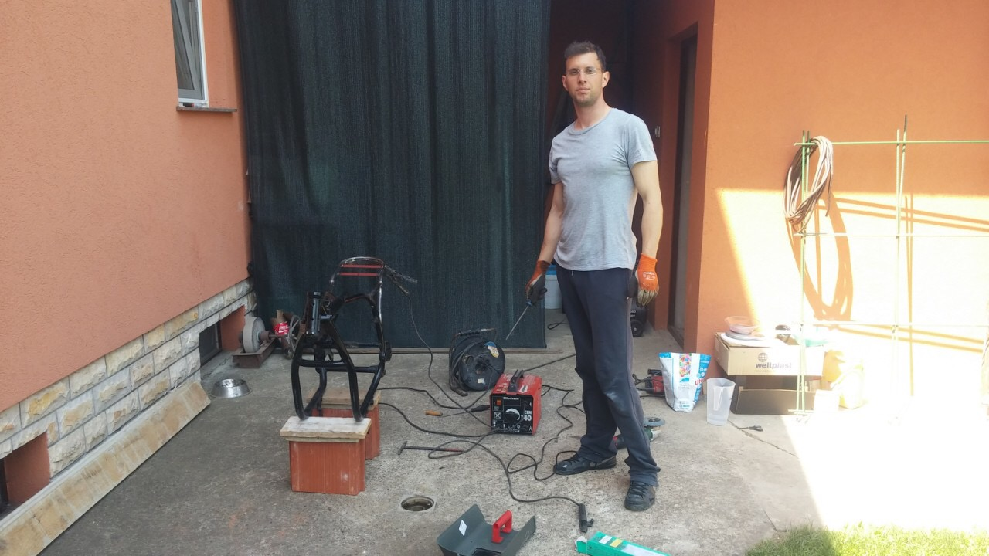
MY TEACHER’S HOBBY
4.QUESTION:How old were you when you were driving the motorcyle for the first time?
ANSWER:When I was 28, I passed the driving test for motorcycle and drove a motorcycle for the first time, but I was driving a scooter in elementary school, but of course, only in my street.

Slide 6
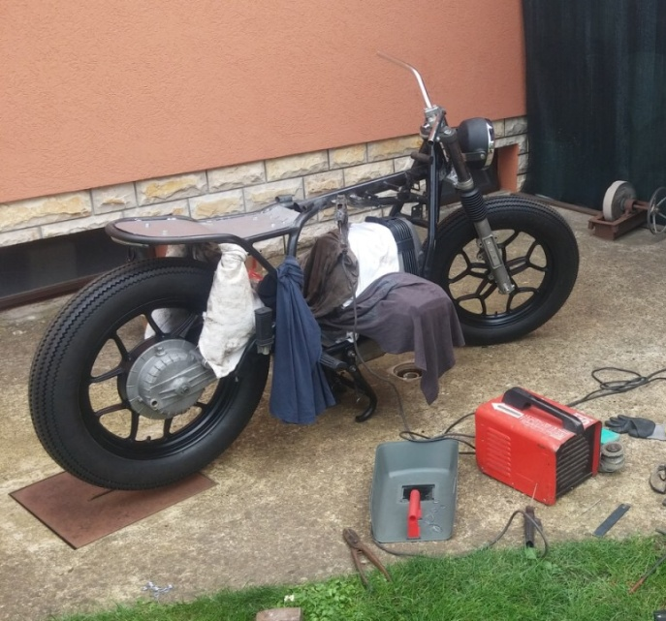
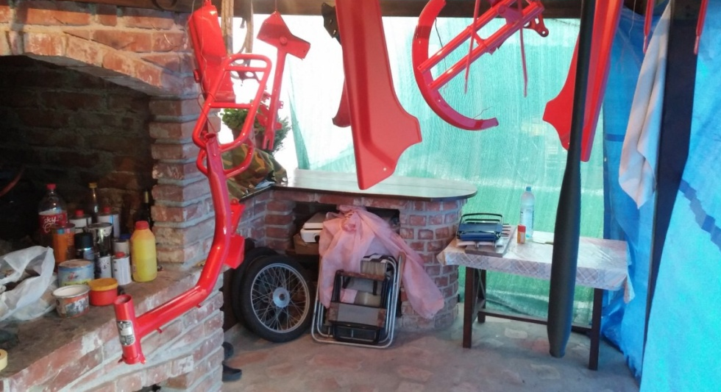
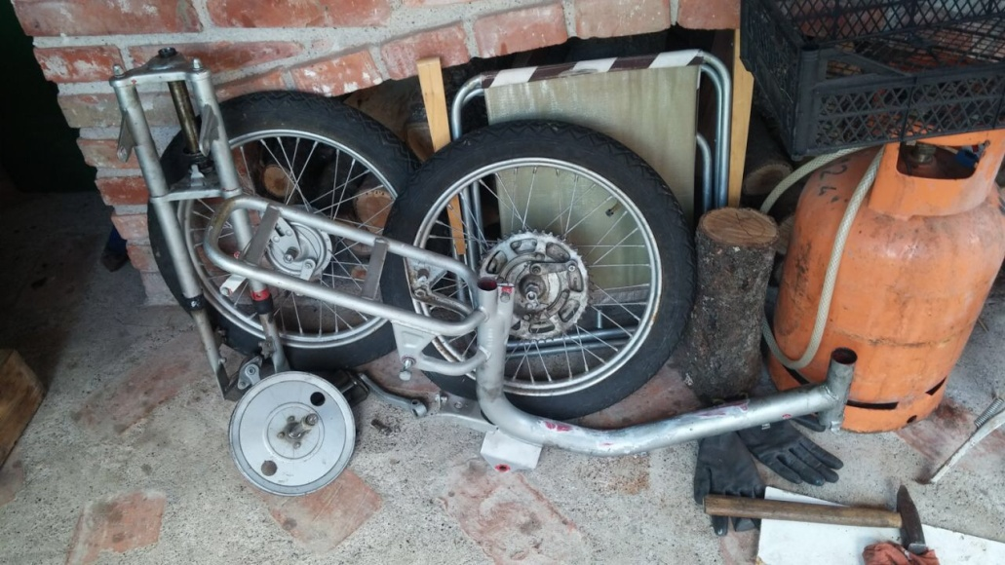
MY TEACHER’S HOBBY
5.QUESTION:Why do you like engines?
ANSWER:I like engines because they look very nice and because I enjoy to rearrange and drive them.

Slide 7
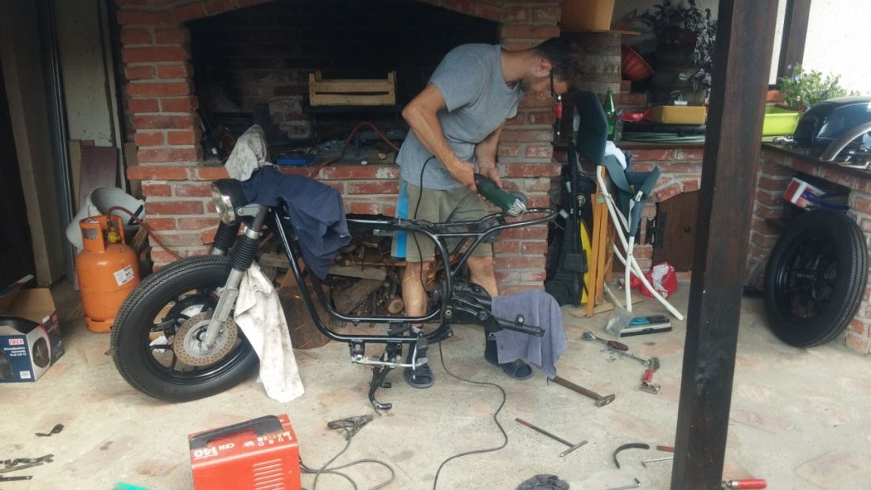
MY TEACHER’S HOBBY
6.QUESTION:How did you became interested in motorcycles?
ANSWER:The reason is kinda unusual.I didn’t knew anything about engines and motorcycles, so I felt kinda embarrased because I’m a man and I don’t know anything about engines.

Slide 8
MY TEACHER’S HOBBY
7.QUESTION:What do you like the most about motorcycles?
ANSWER:I can’t pick anything special. I like old road motorcycles and they’re retro style.
Before
After

Slide 9
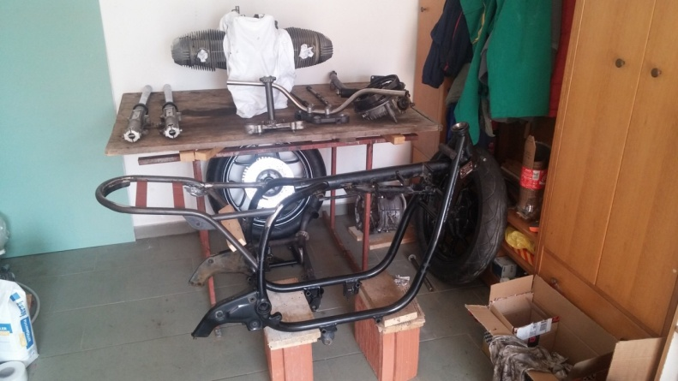
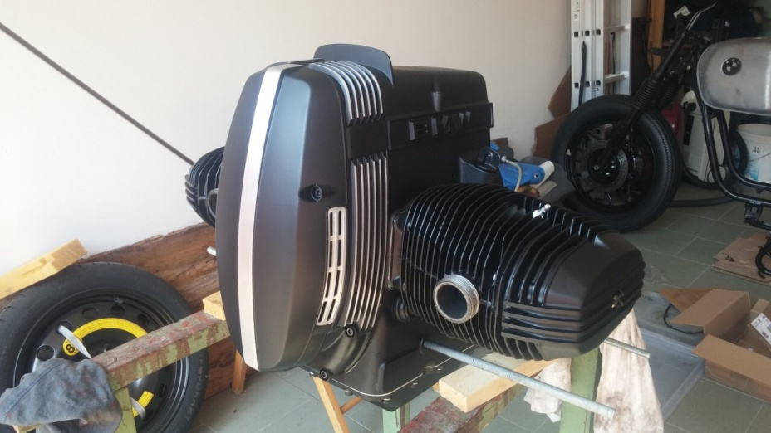
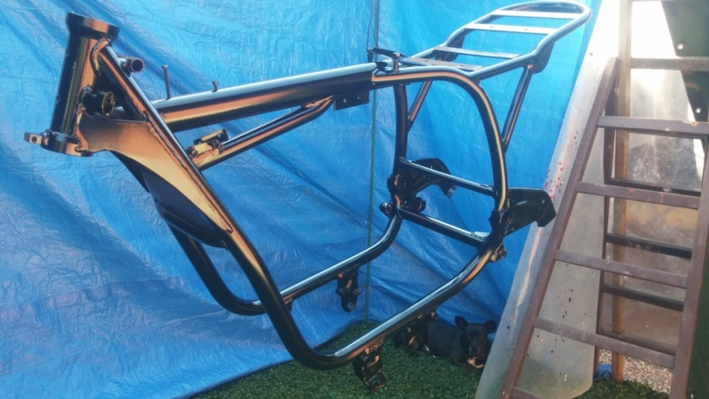
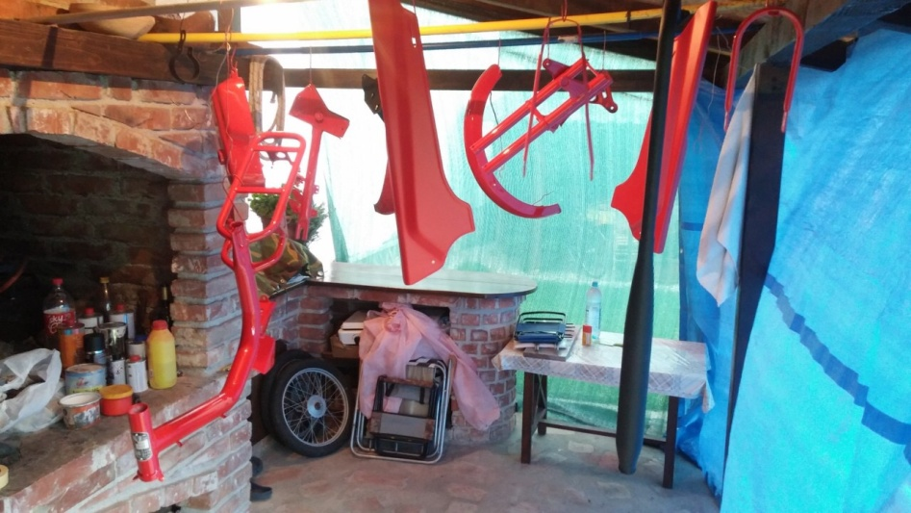
MY TEACHER’S HOBBY
8.QUESTION:How long does it take to you to put together an engine?
ANSWER:Since I work a lot, I don’t have enough time to work with engines, so because of that it takes me an year, but again it depends onwhat you want to do.For the projectof remaking the BMW, from the idea until the realisation, 3 years have passed.

Slide 10
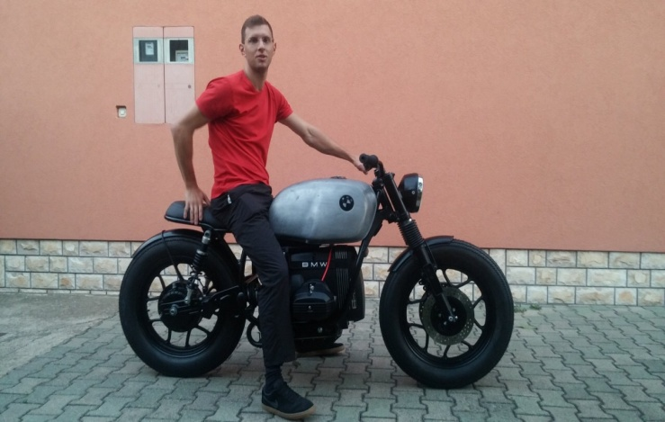
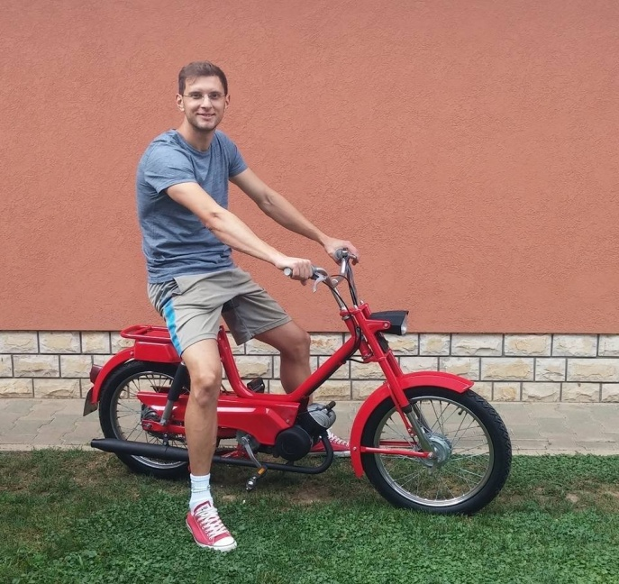
MY TEACHER’S HOBBY
9.QUESTION:Is it hard to put the motorcycle together? ANSWER:It’s not to me because I do what I love.

Slide 11
MY TEACHER’S HOBBY
10.QUESTION:Was anyone helping you with the motors at the beginning?
ANSWER:I was mostly learning with the help of books and the Internet, but there was always my father and he was always here to help me.

Slide 12
MY TEACHER’S HOBBY
11.QUESTION:How many motorcycles have you put together?
ANSWER:I’ve putted up 2 motorcycles and those are the 2 ones that I own, Tomos has been restored to the original condition, and BMW has been transformed into a “cafe racer” and l also have an idea for the third project.

Slide 13
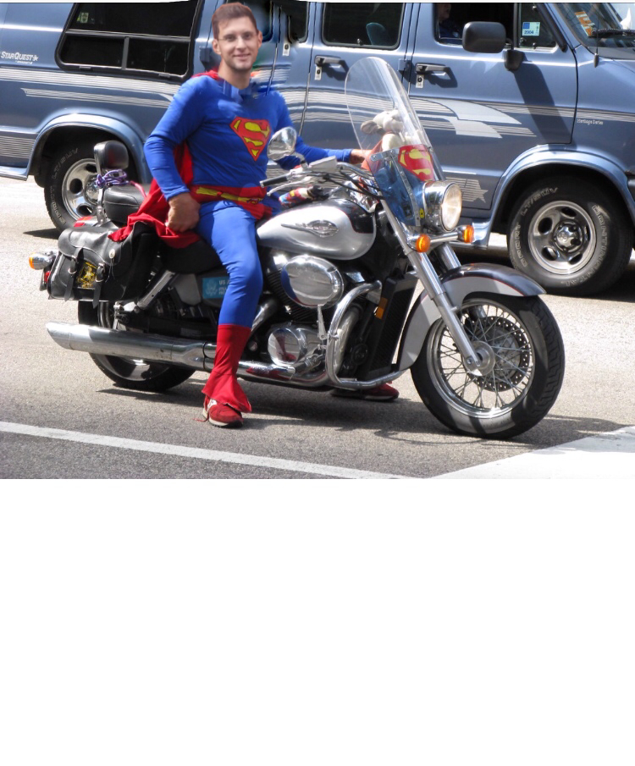
Made by:Lea Košir

