Slide 1
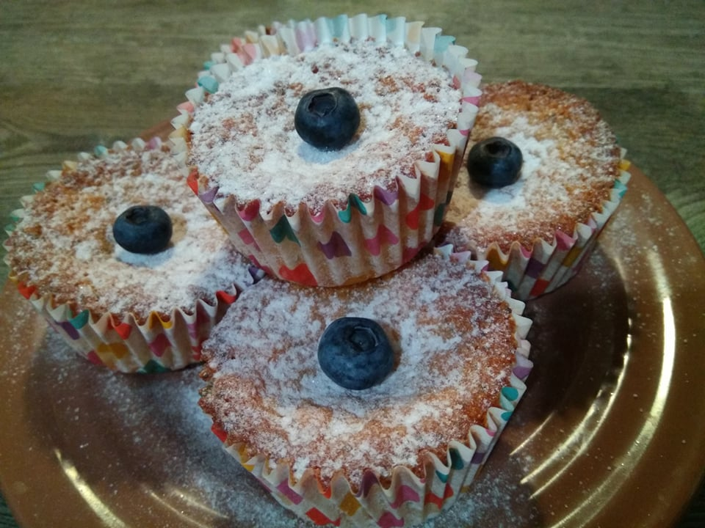
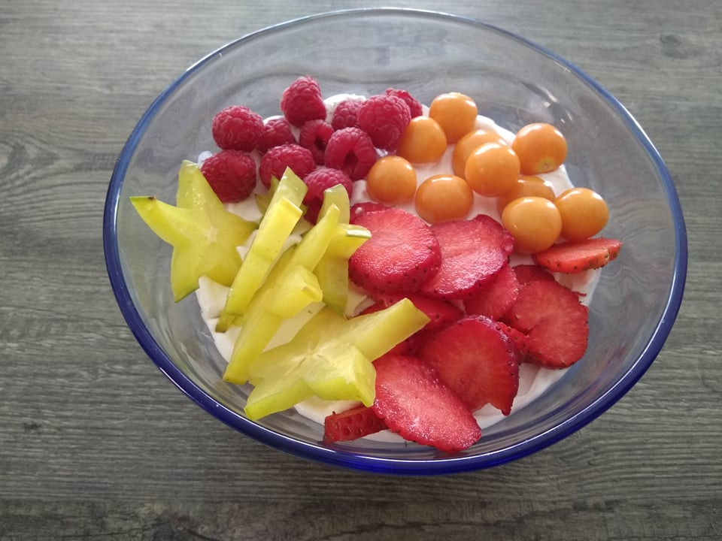
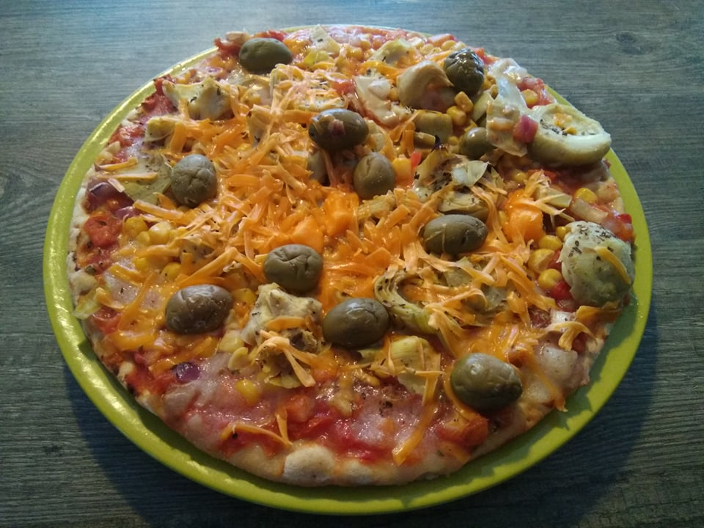
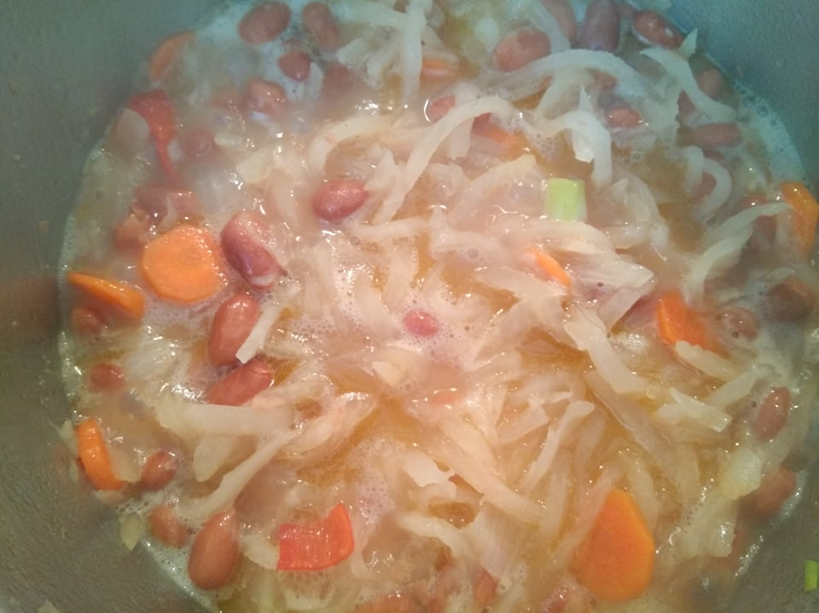
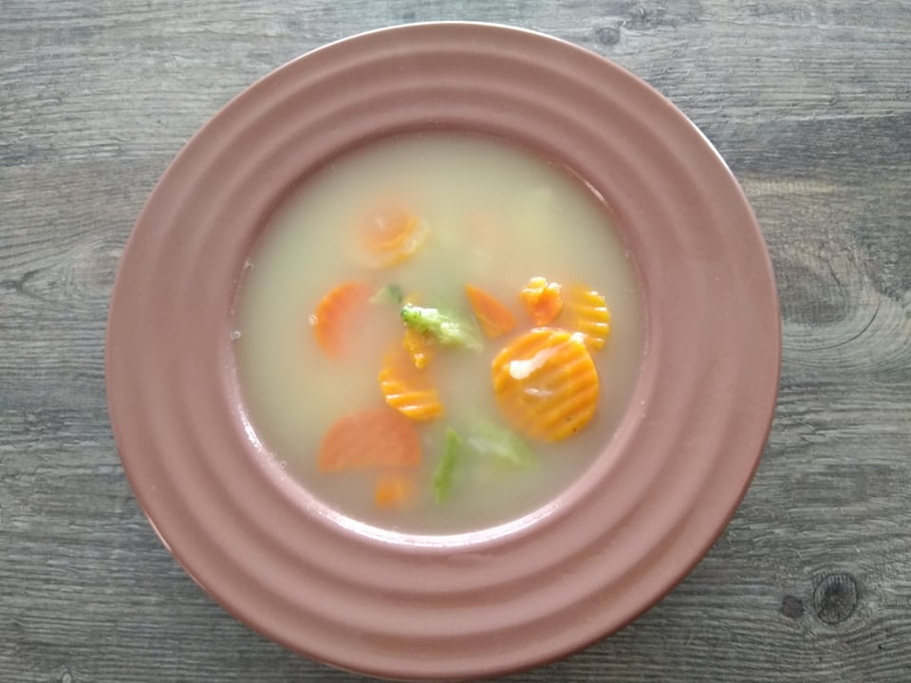
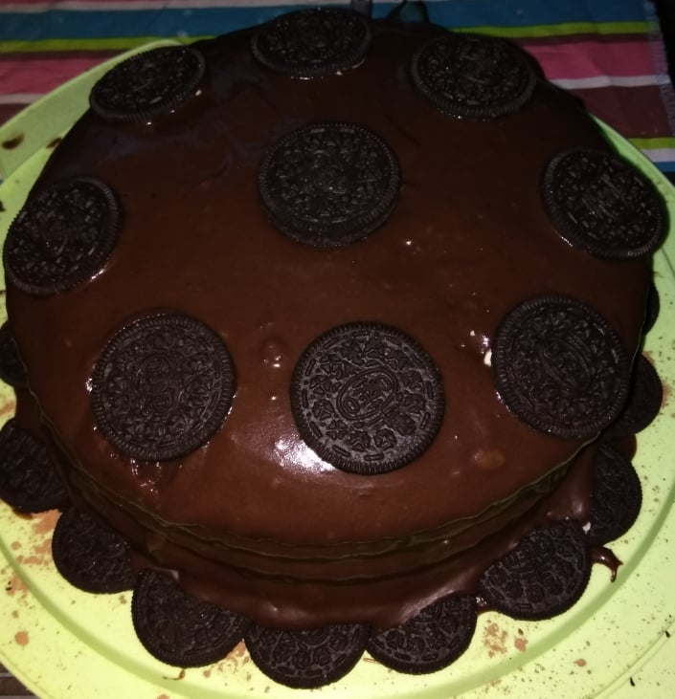
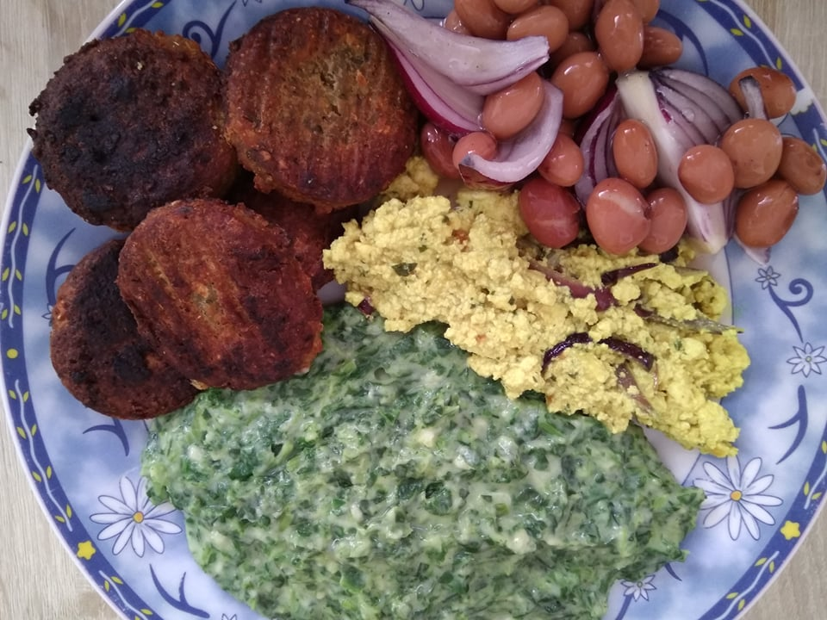
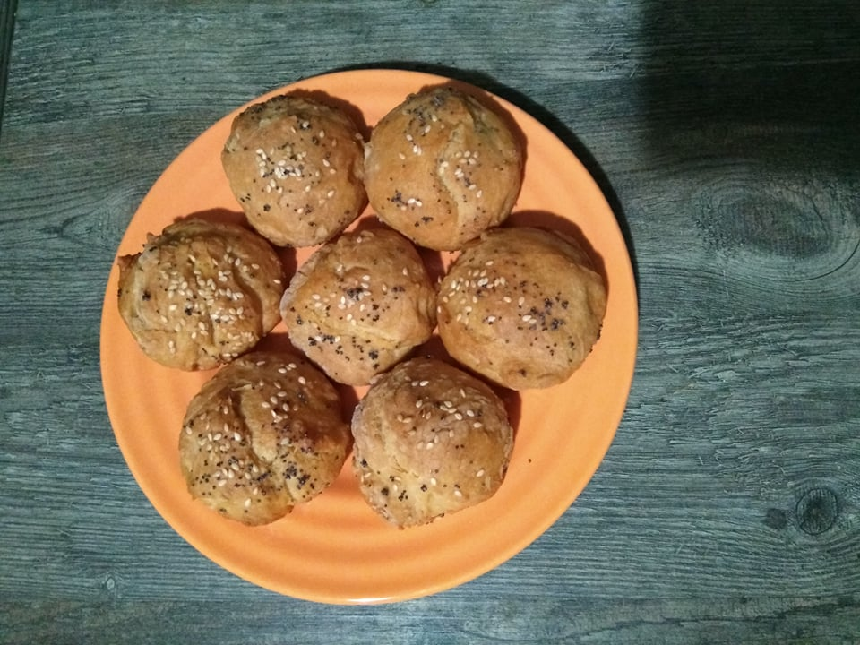
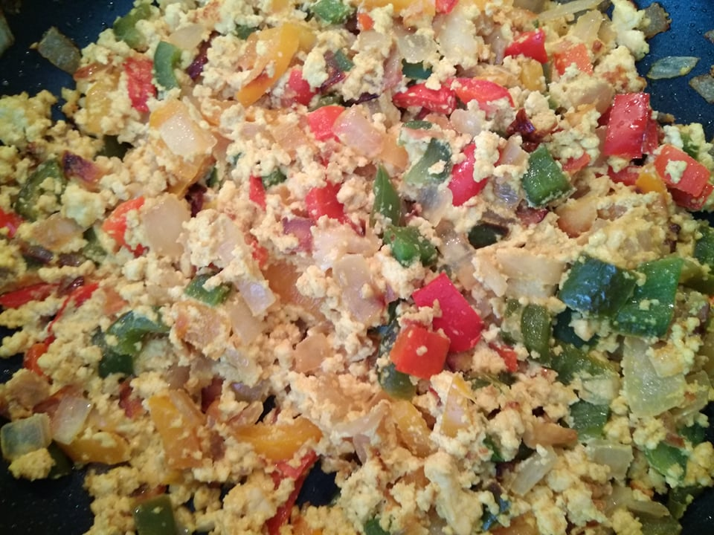
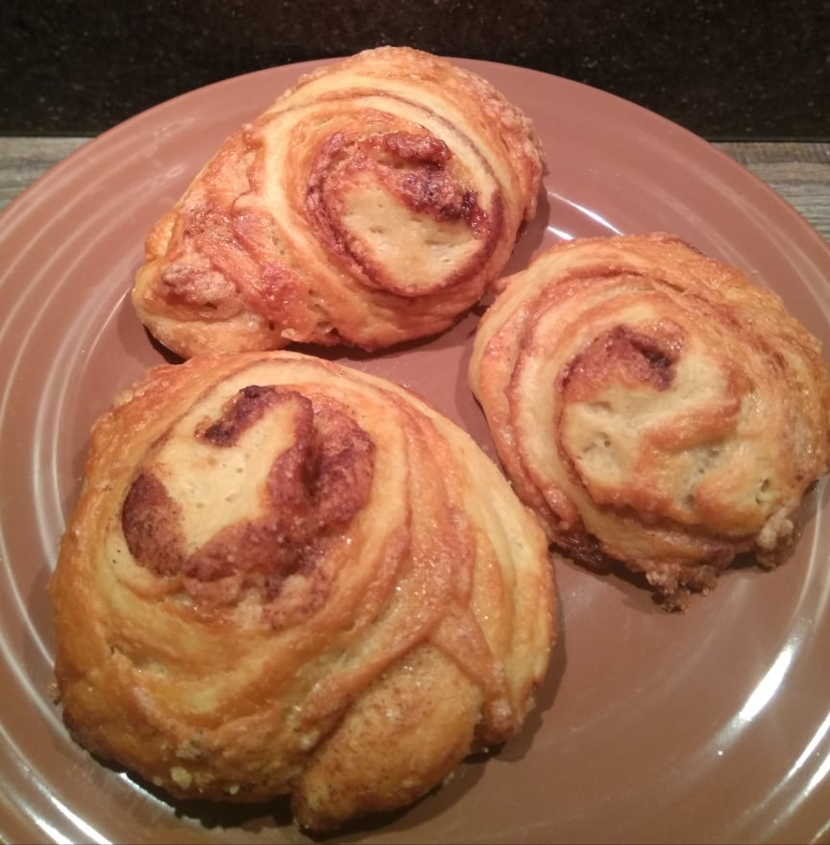
Teacher’s hobby
Made by Karlo Kampić and Hana Helena Beljo

Slide 2
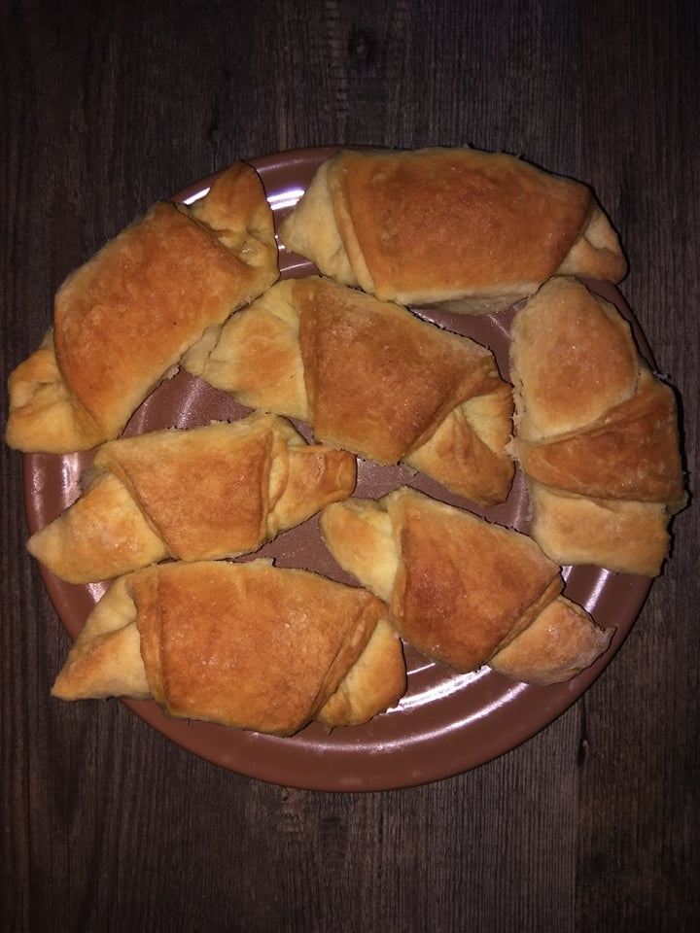
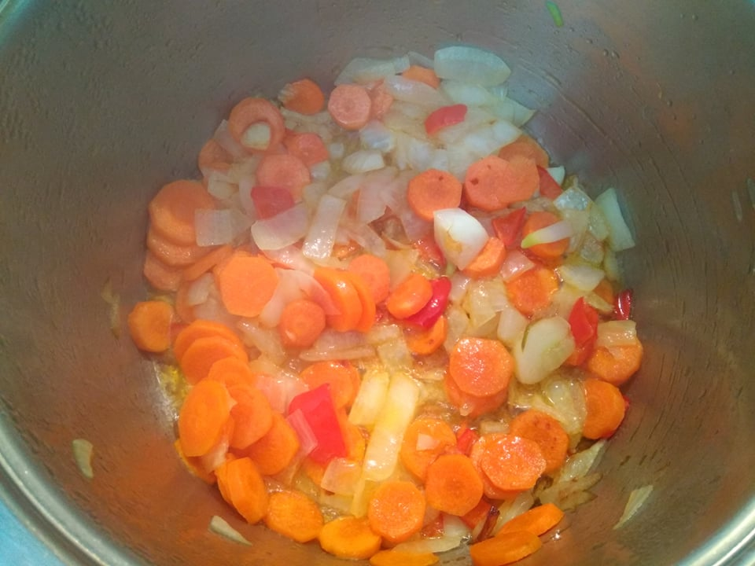
Hi there, we are going to ask our teacher some questions about her hobby.
Her hobby is vegan cooking.
So let’s go ask her questions. ☺

Slide 3
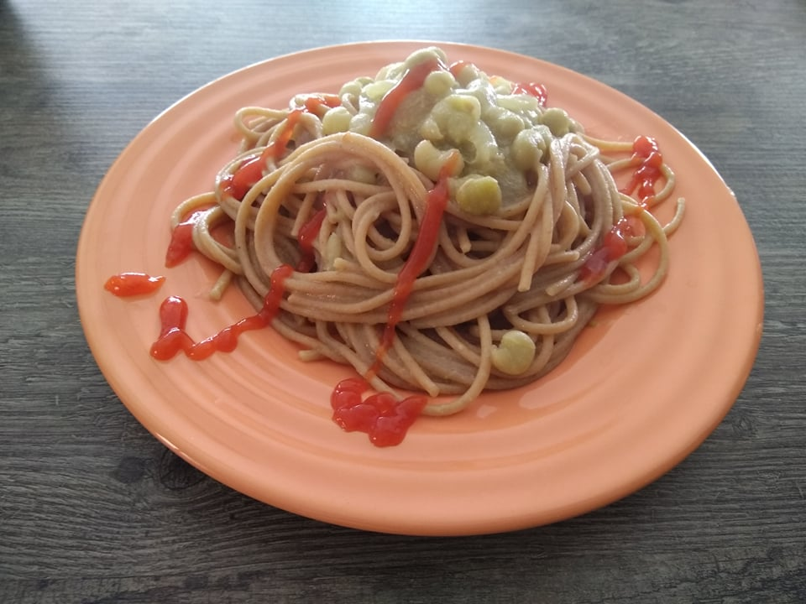
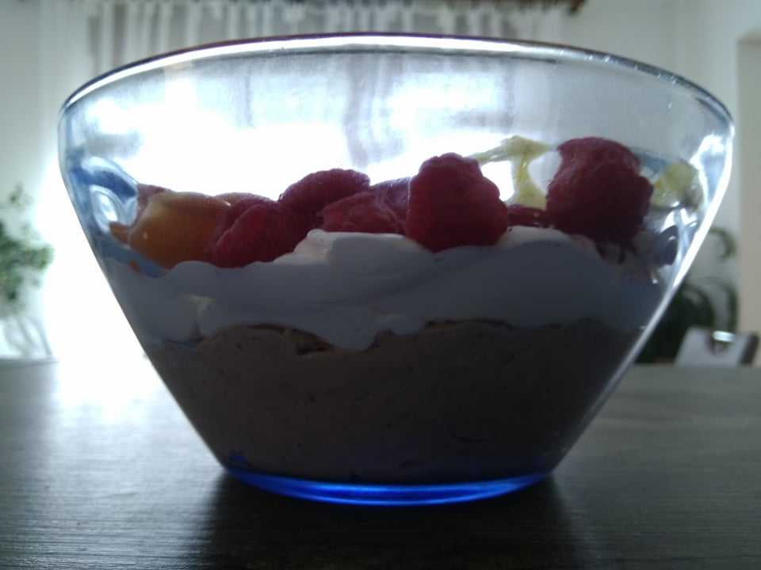
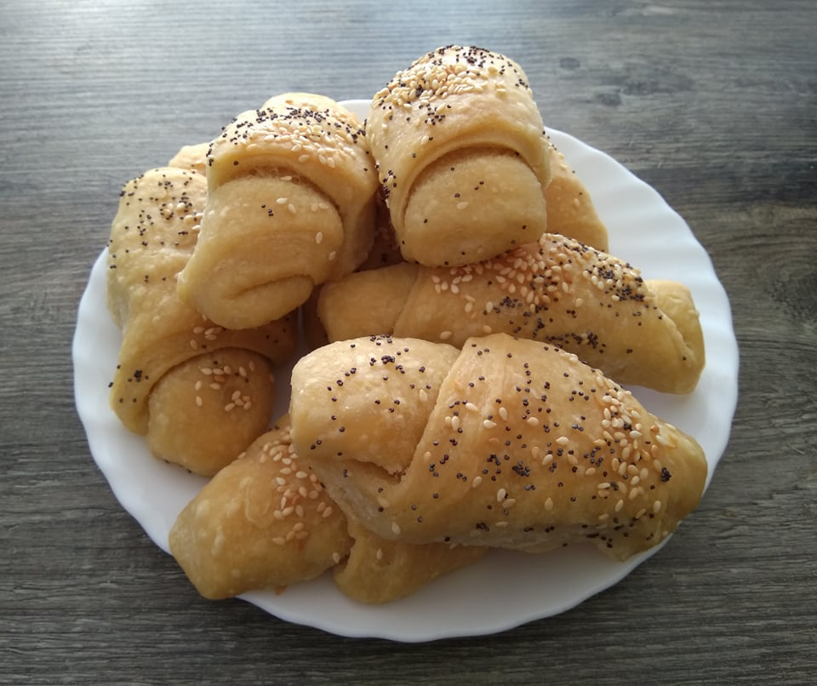
Vegan Cooking
Us: Why do you like vegan cooking?
Teacher: I like it because it gives me a chance to experiment, taste, invent and enjoy, but at the same time to stay on my biggest mission in life – saving animals. Since vegan cooking equals all the taste and no animals hurt. ☺

Slide 4
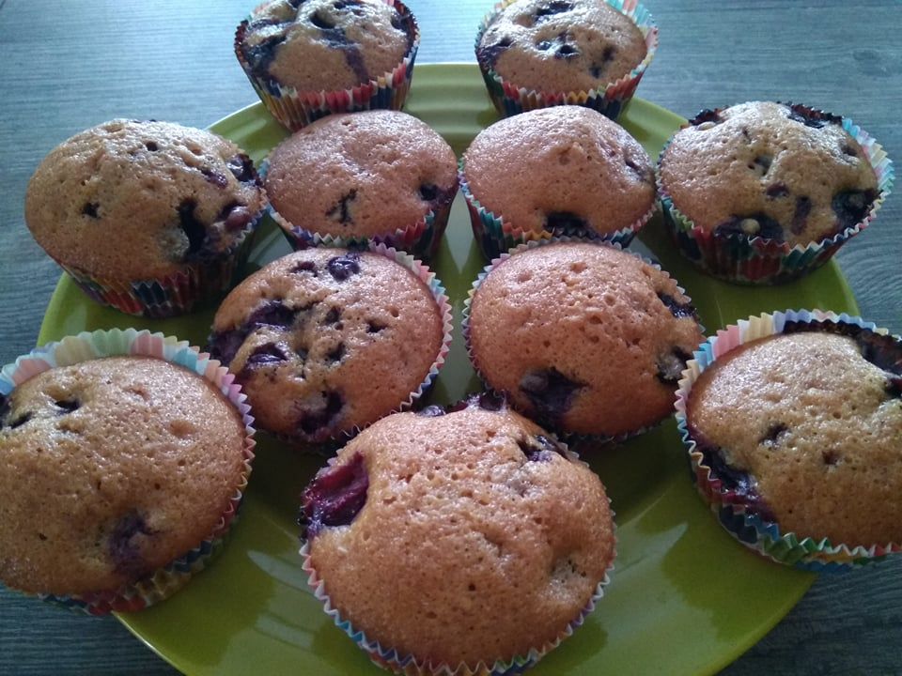
Vegan Cooking
Us: What do you like to cook?
Teacher: I like to cook and make and bake everything. From savory dishes to sweets, jams, sauces, juices… you name it, I like to make it ☺
Us: What’s your favourite meal?
Teacher: My favourite meal is spaghetti and tomato sauce, topped with coconut or soy cheese. I just love it!

Slide 5
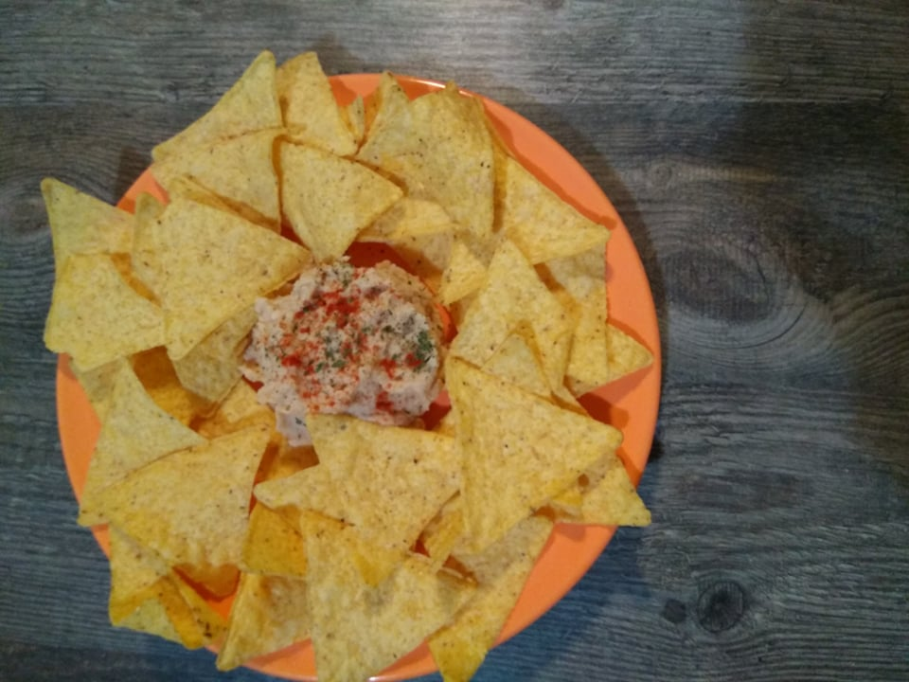
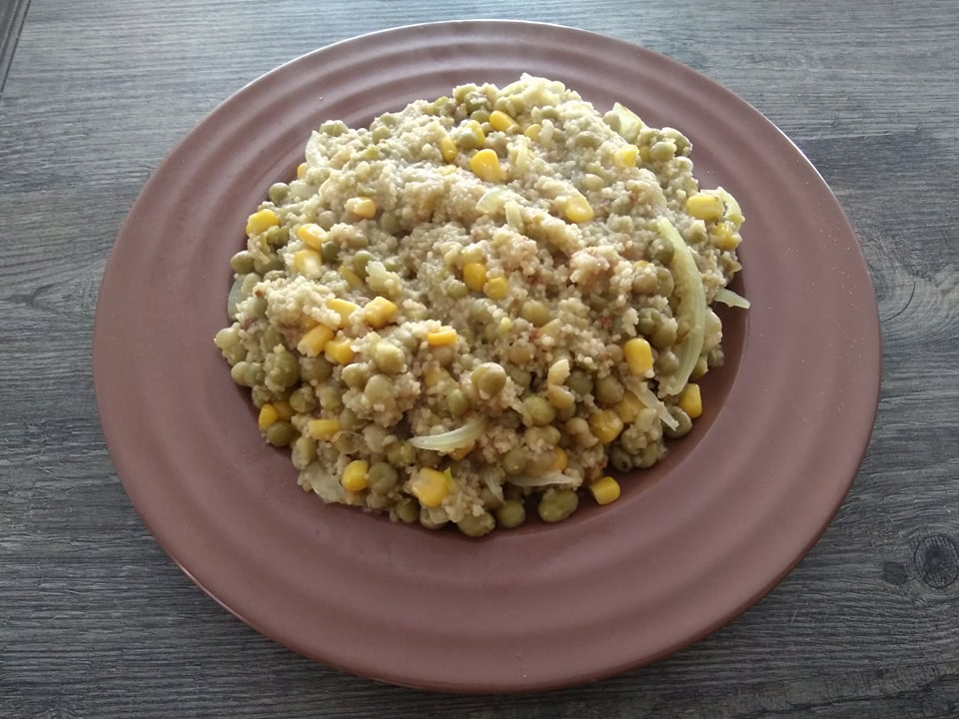
Vegan Cooking
Us: So you don’t just cook Croatian meals?
Teacher: No, I adore international quizine, especially those dishes that are by default vegan, and those national quizines that are mostly vegan.

Slide 6
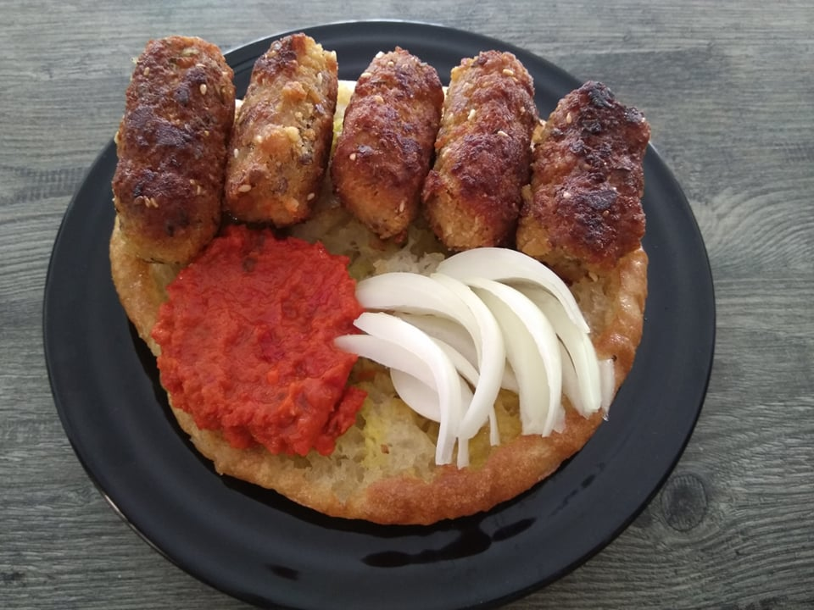
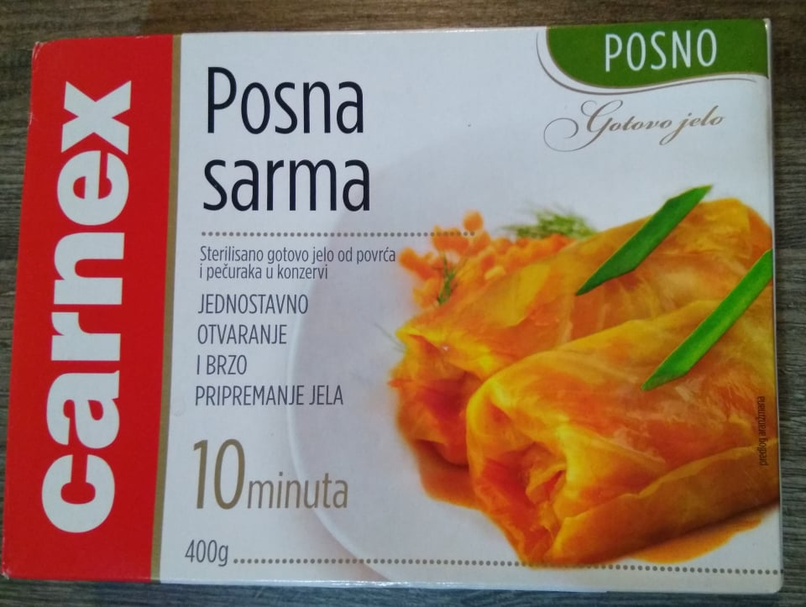
Vegan Cooking
Us: When you went to other countries did you get some inspiration about vegan meals?
Teacher: All the time. If I see something I like, and it’s vegan, I try it. I have always loved all the vegan things I tried. If I see something and it is not already vegan I think how to veganize it and I always succeed.
Us: Which meals can you veganize?
Teacher: Every meal that I like. Every Croatian meal, even „Sarma” can be veganized, in fact there is a Serbian version „Posna sarma” which they eat all over his region and it’s so delicious.

Slide 7
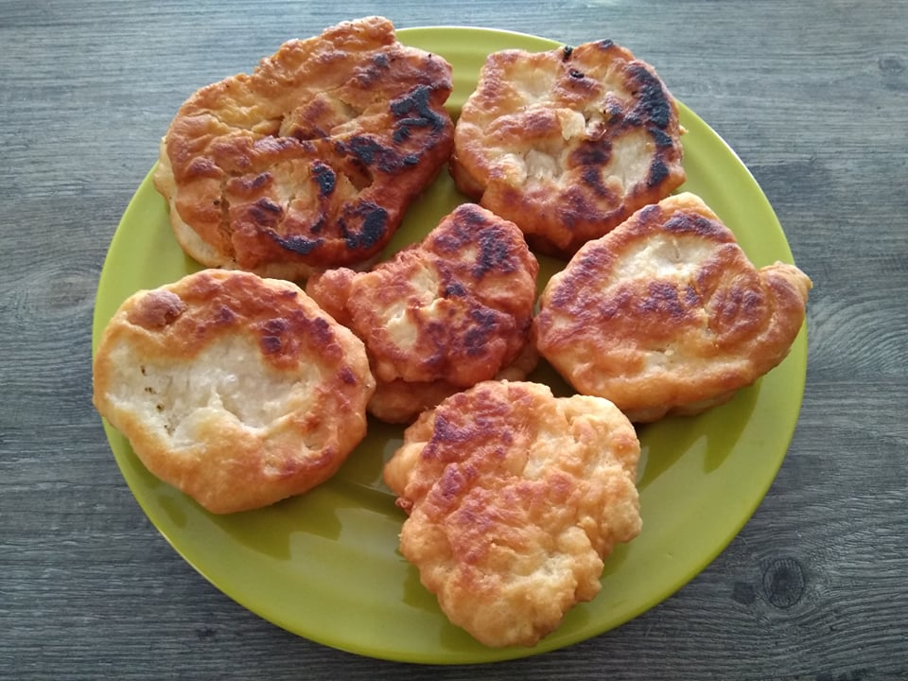
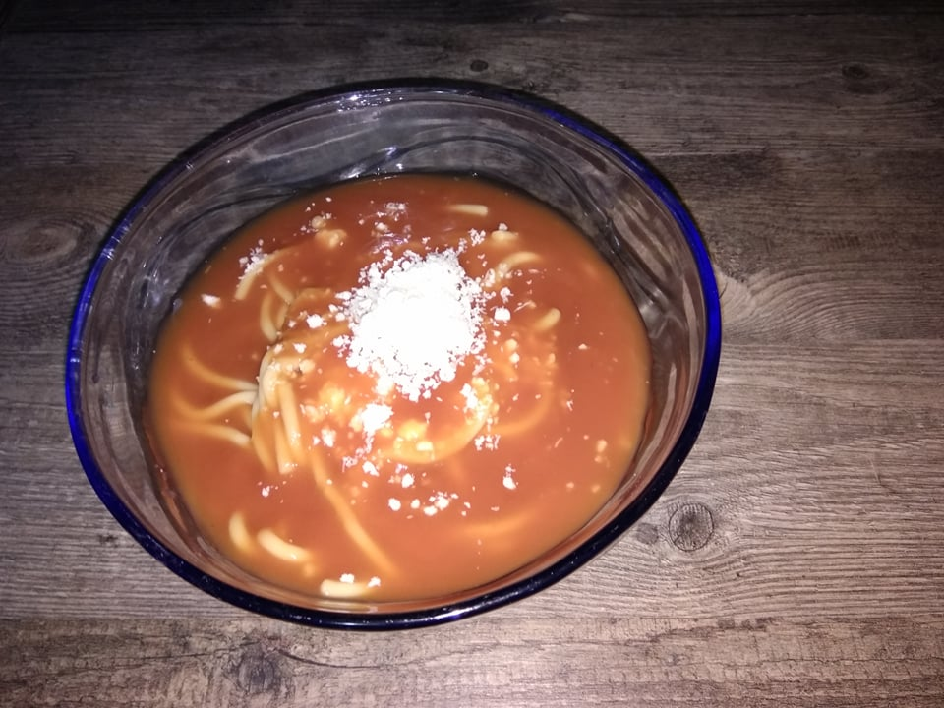
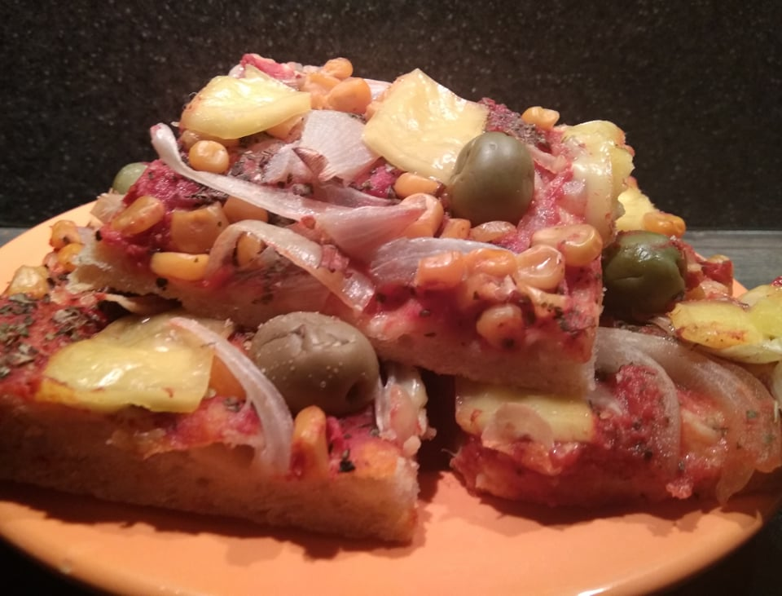
Vegan Cooking
US: What meals do you cook often?
Teacher: Besides spaghetti and tomato sauce, pizza is also very often on my menu. And pancakes, salty or sweet.

Slide 8
Vegan Cooking
Us: How do you veganize things like pancakes for example?
Teacher: You don’t have to substitute for eggs or milk. They turn out just fine without them, but you can use bananas or apple sauce for sweet version, and chia or flax seeds for a salty version, if you want.

Slide 9
Vegan Cooking
Us: What seasonings do you like to use?
Teacher: I like them all. Cumin, curry, cinnamon, ground pepper or garlic, everything has a place and a purpose. ☺

Slide 10
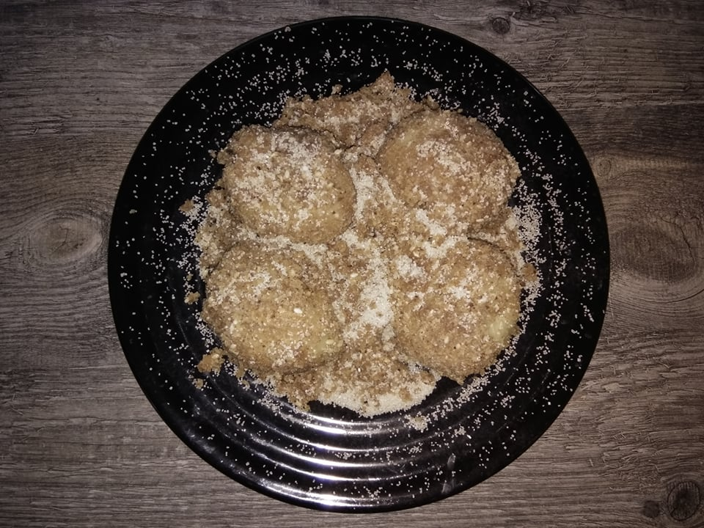
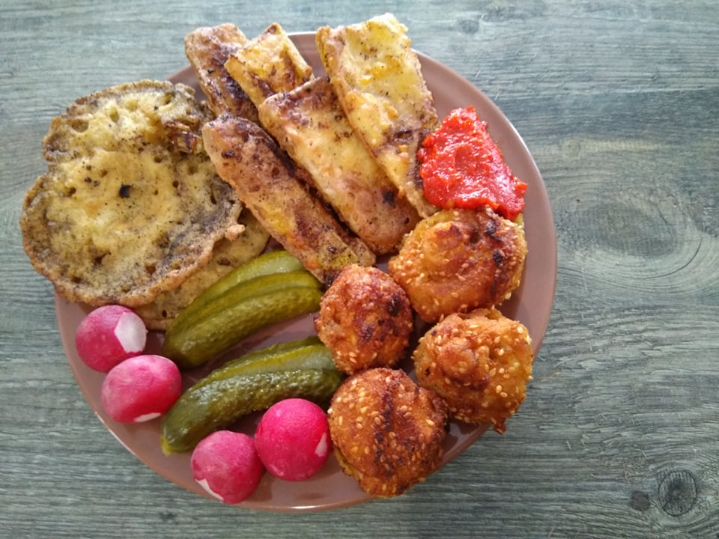
Vegan cooking
Us: Do you like to make meals for small group of people or bigger groups of people?
Teacher: I like cooking a lot, so making a lot of food for a lot of people is my favourite. That’s why I like celebrating at my home, and have people over very often.☺

Slide 11
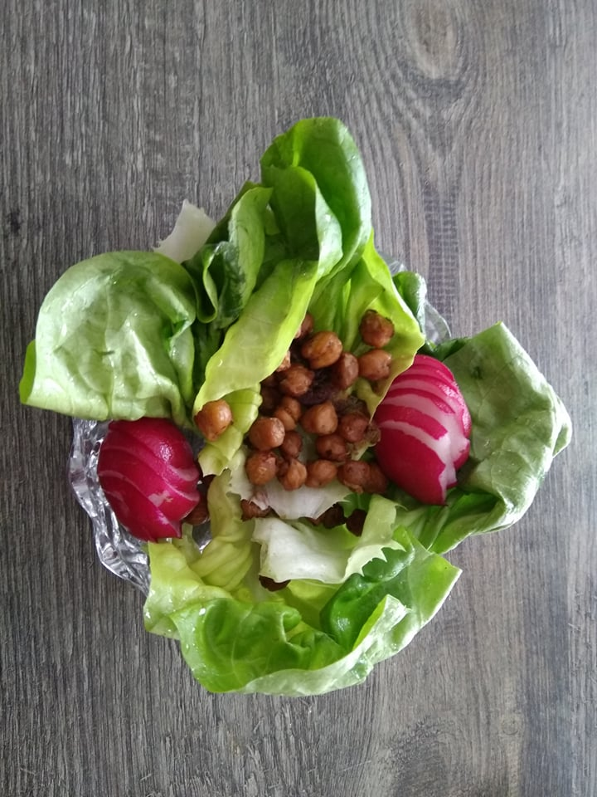
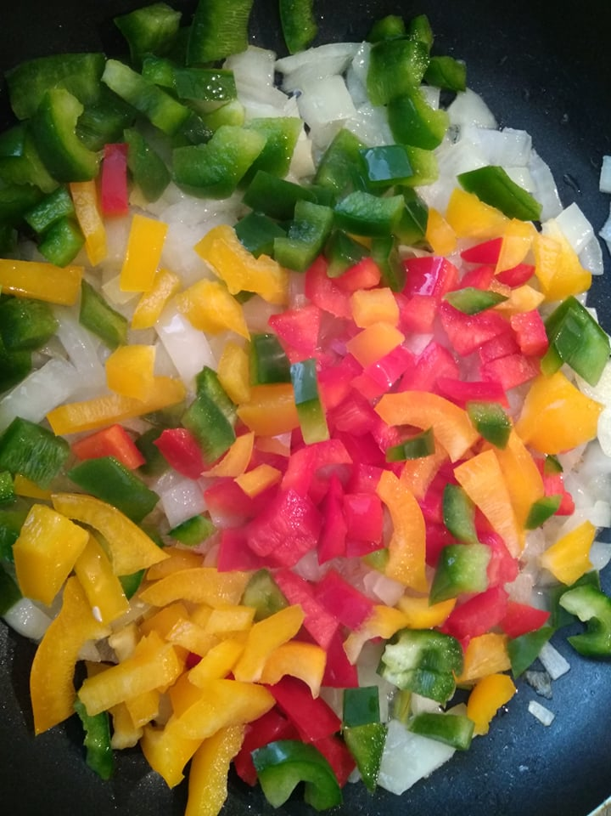
Vegan Cooking
Do you have other hobbies? Tell us something about them.
Teacher : I do. I like helping animals but it’s a lifestyle, not a hobby. I also like reading a lot, especially crime stories. I like travelling. I have visited more than 30 countries so far.

Slide 12
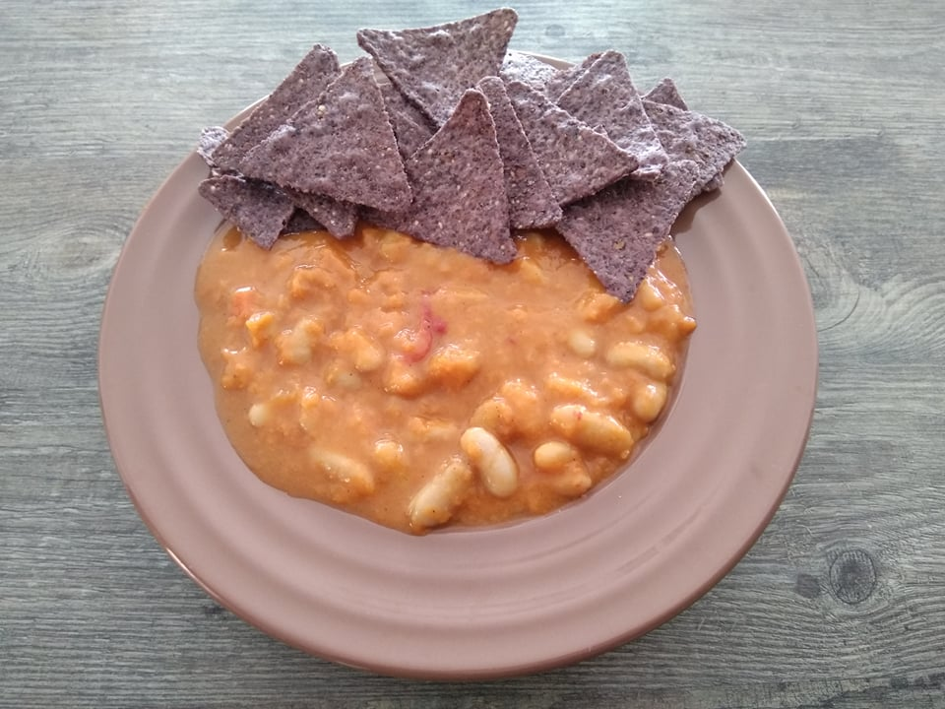
Thanks for watching and have a great day

