Slide 1
An interview with my teacher
My hobby
Anamarija Lovrić and teacher Sanja Lončar

Slide 2
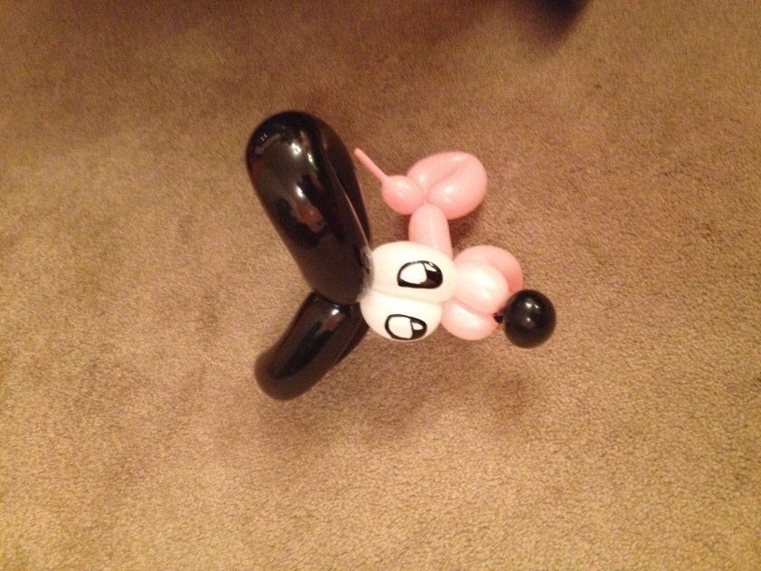
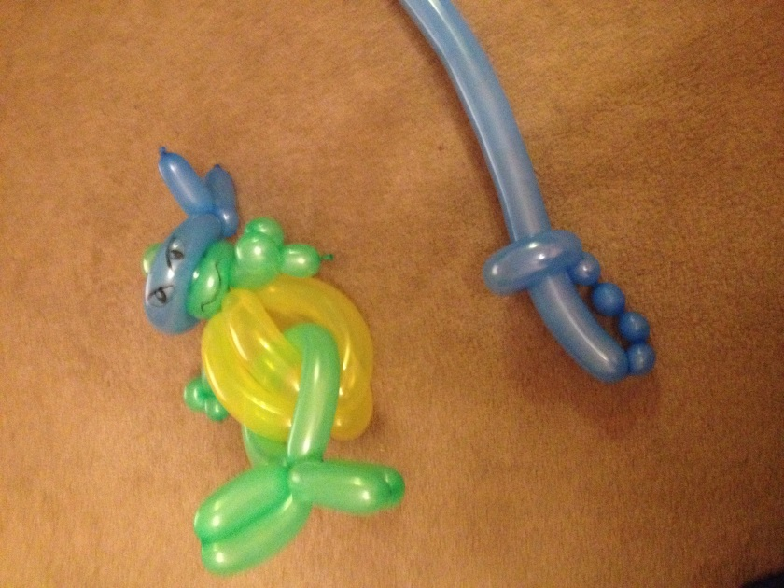
Can you guess my teacher’s hobby?

Slide 3
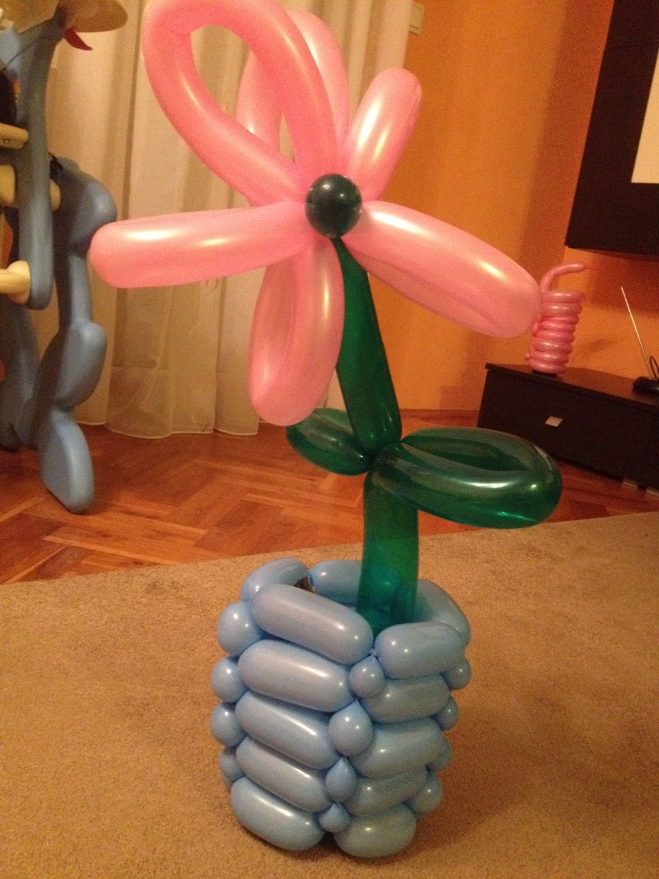
It is twisting balloons!!!

Slide 4
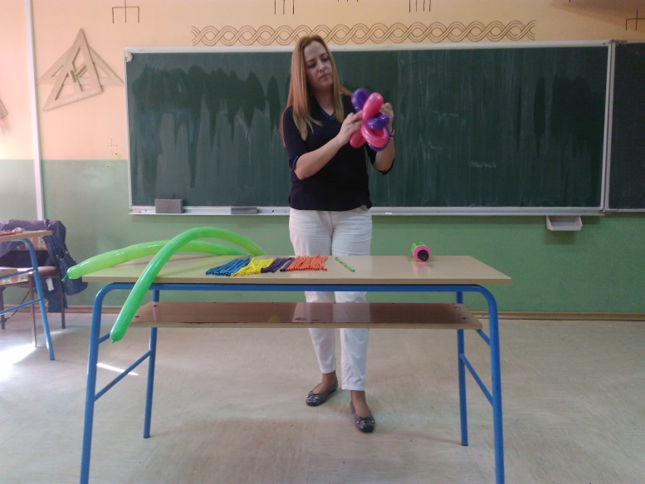
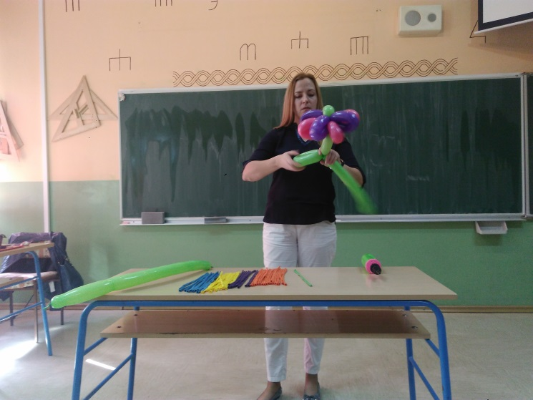
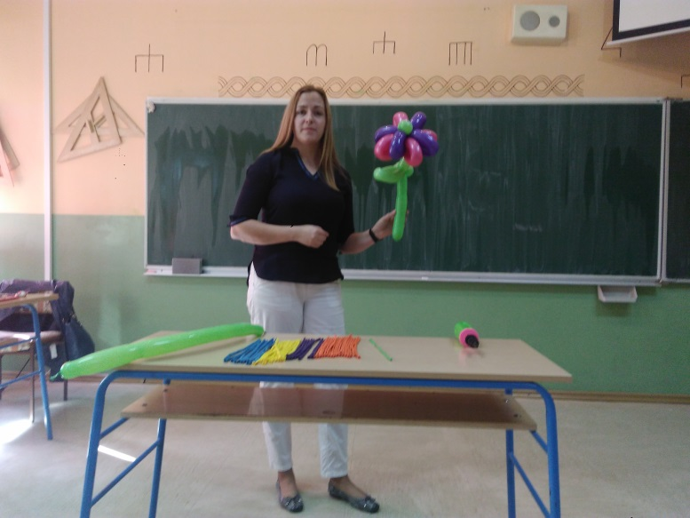
Have I got some questions for her...

Slide 5
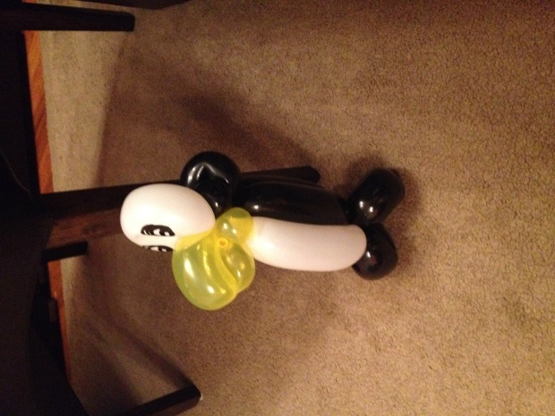
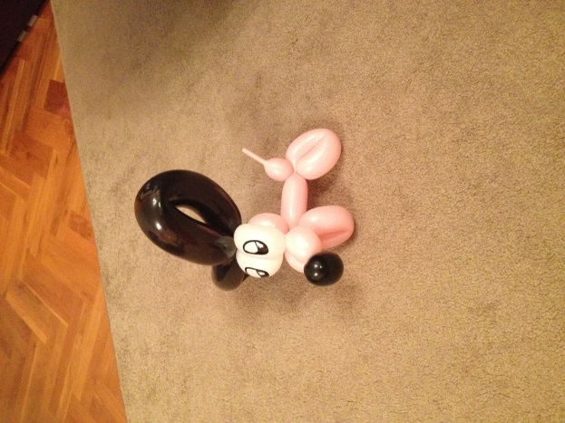
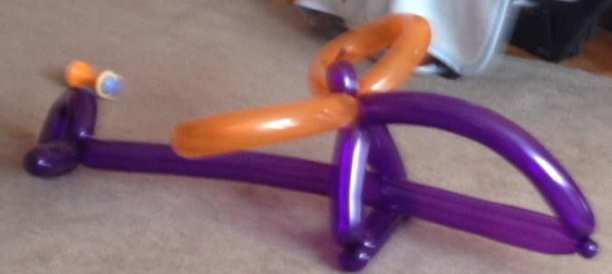
When did you start making balloon animals?
I started making balloon animals for my children a few years ago. Balloon animals are everywhere around us now. In stores, at the mall, kids parties... My children are awestruck by them.

Slide 6
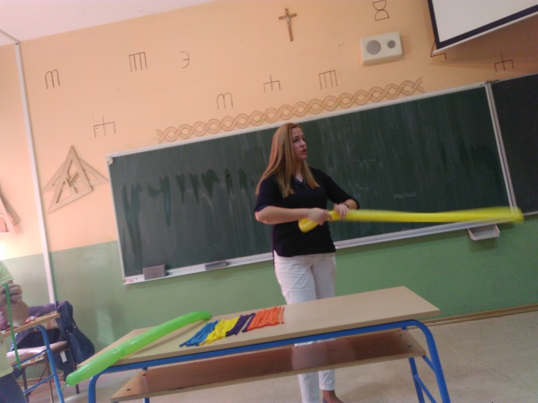
What is the most difficult object you have ever made?
I love making flowers, swords, dogs, butterflies. I can also make hats, crowns, baskets, bracelets... But the most difficult ones were ninja turtles. I wanted to make them for a friend. They were really challenging for me.

Slide 7
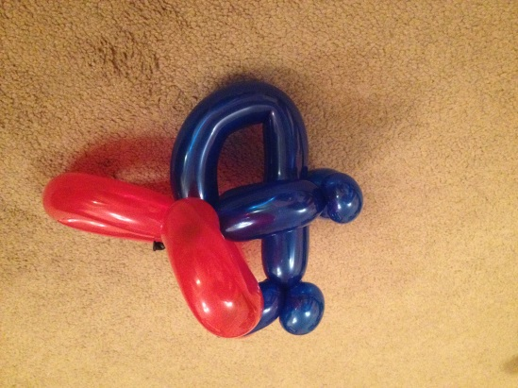
How did you learn making balloon animals?
There are many instructions and tutorials on the internet. You can learn how to make and twist balloon animals online. Ranging in difficulty from beginner to intermediate. When I want to make something new I just look it up.

Slide 8
What do I have to do if I want to learn how to twist balloons?
Firstly,find informative videos which offer helpful tips. You'll need advice to get you past common difficulties that beginners often encounter. Then, all you really need are some good quality balloons and a balloon pump. You can start with simple structures like a dog balloon. Many other animals such as the deer and giraffe are variations on the dog balloon. You should learn that one first.

Slide 9
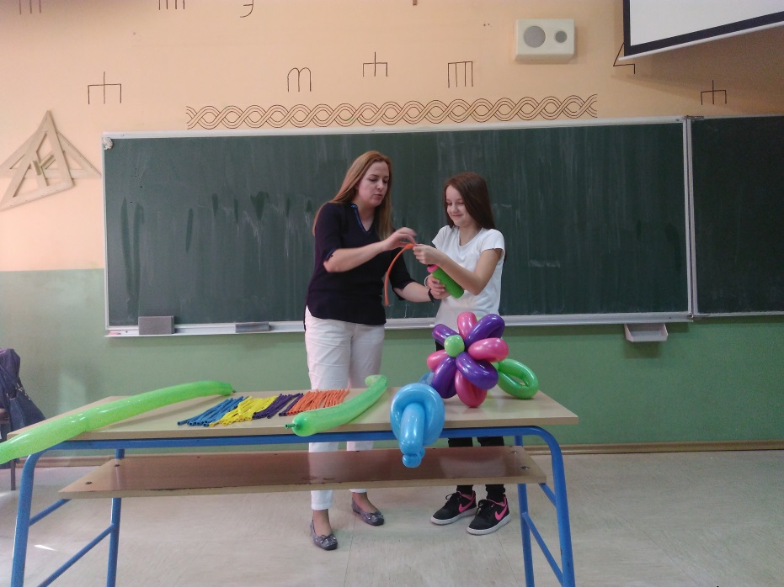
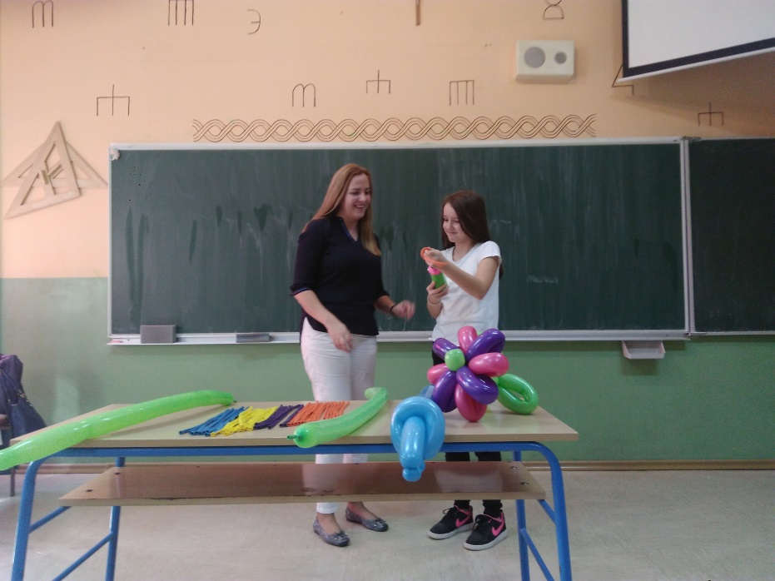
Can you show me how you do it?
Sure, come here and take that balloon pump! Let’s begin!

Slide 10
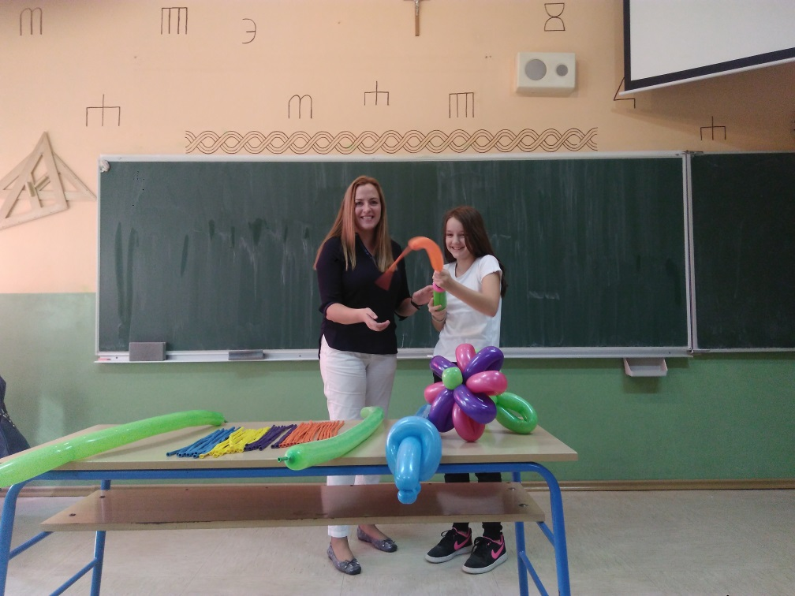
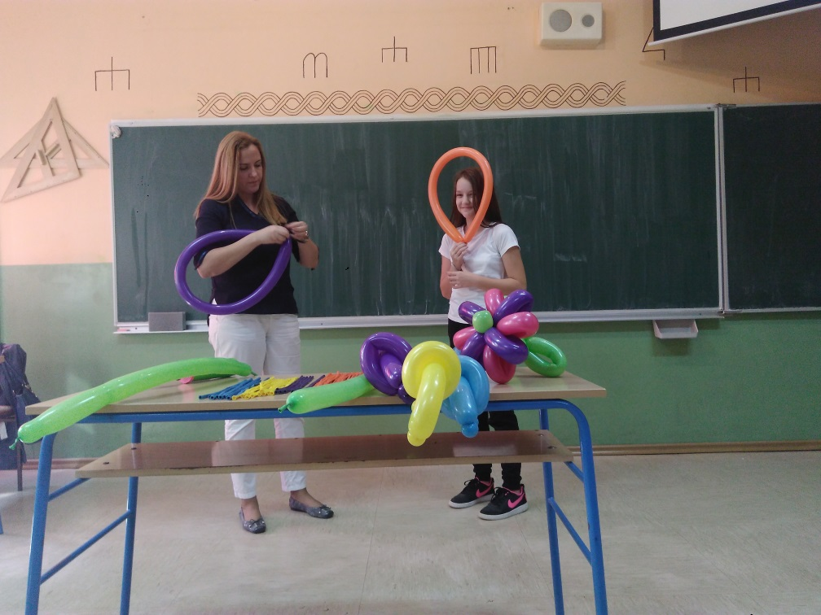
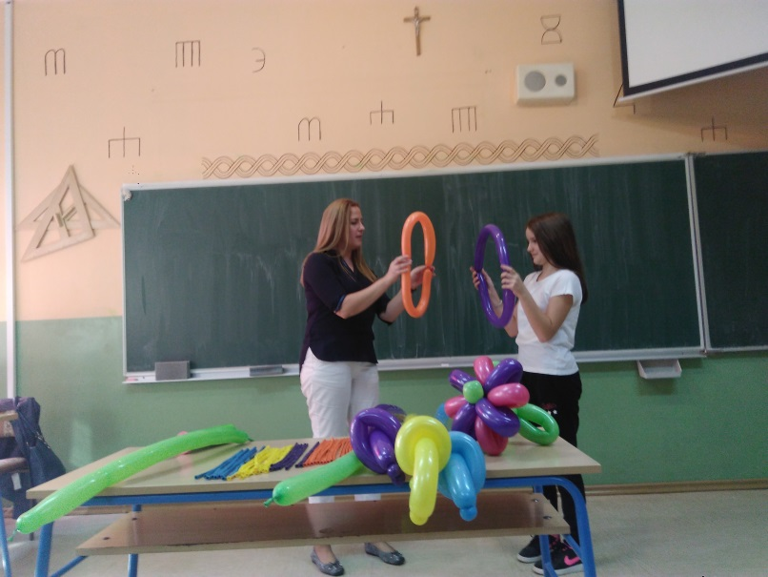

Slide 12
So much happiness!!!

Slide 13
Thank you for your attention

