Slide 1
English Across the Curriculum/CLIL
Valentine’s Day, 2018
at Antun Gustav Matoš
Vinkovci, Croatia

Slide 2
Celebrating Valentine’s Day is a part of a citizenship curriculum in Croatian schools
Citizenship education aims to develop the capacity of young people to participate in a fair and inclusive
society throughout their lifetime.
It is implemented, in our Curriculum, as a separate subject but here it is a cross-curricular theme.
We try to promote cross-cultural competences, as the ability to learn and respect cultural diversities, through learning about other cultures, customs and different ways of living.

Slide 3
HAPPY VALENTINES DAY!
There were many different activities in our school at Valentine’s Day.
In this presentation you’ll see how easy and funny can learning be.
We also learned about several subjects in English…

Slide 4
Art lesson (Teacher Ksenija Jurišić and grade 5)

Slide 5
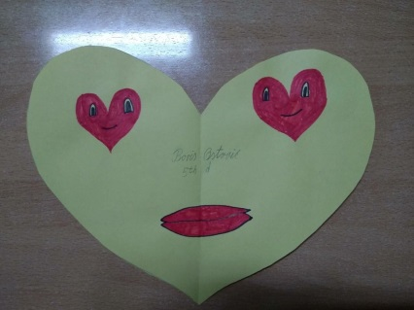
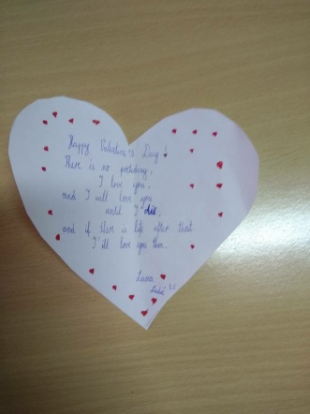
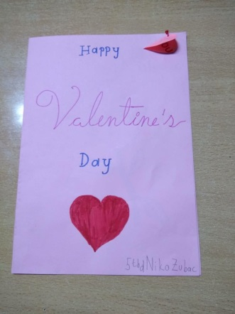
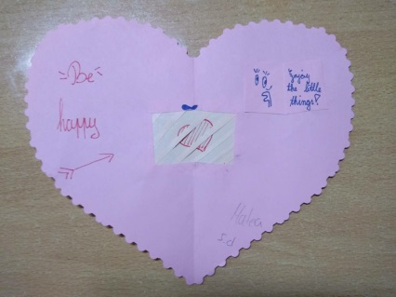
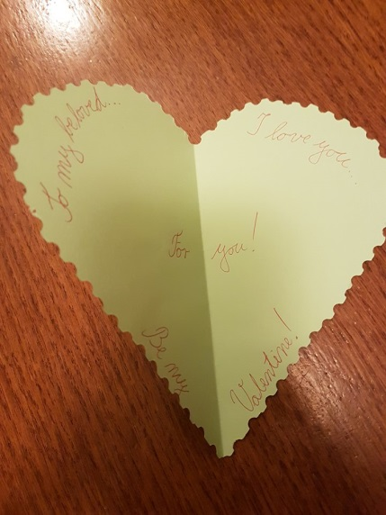
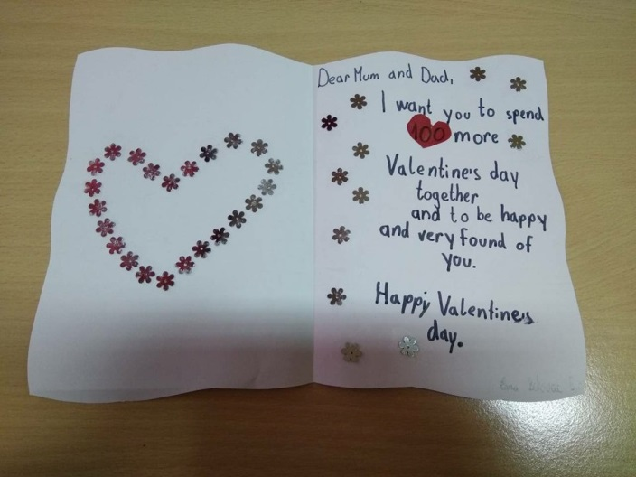
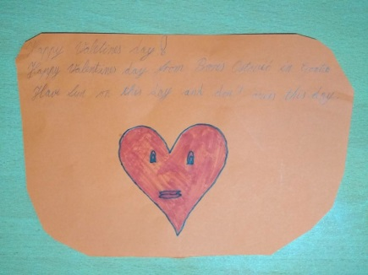
English lesson - Hearts (Teacher Marijana Matorić and grade 5)

Slide 6
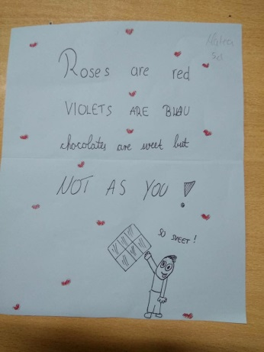
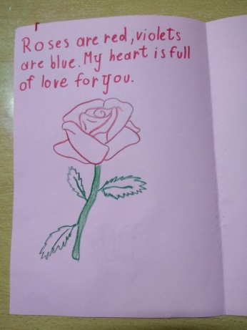
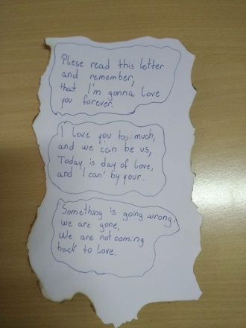
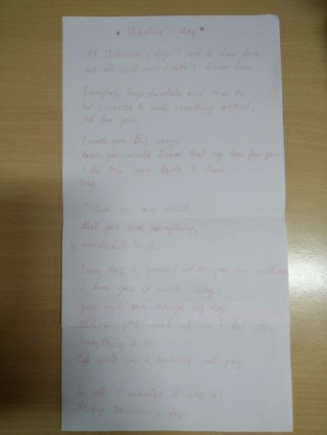
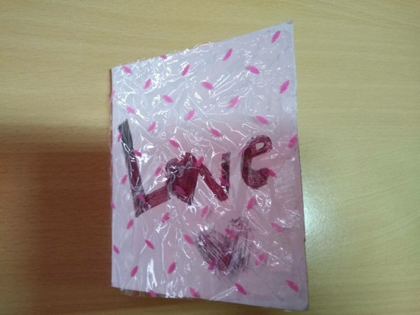
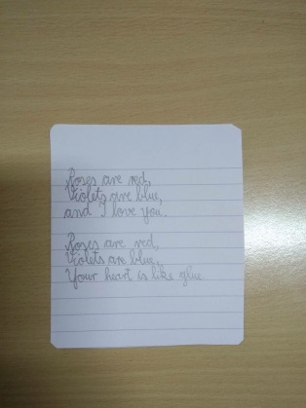
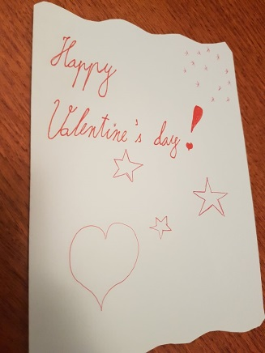
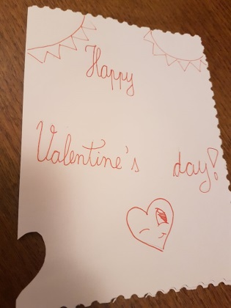
English lesson - letters (Teacher Marijana and grade 5)

Slide 7
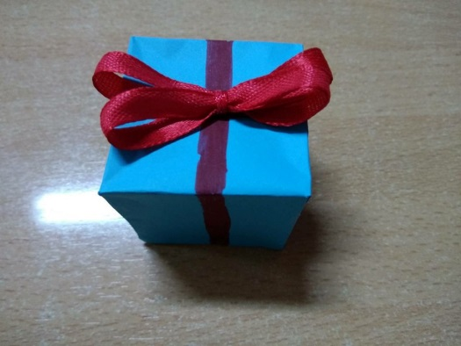
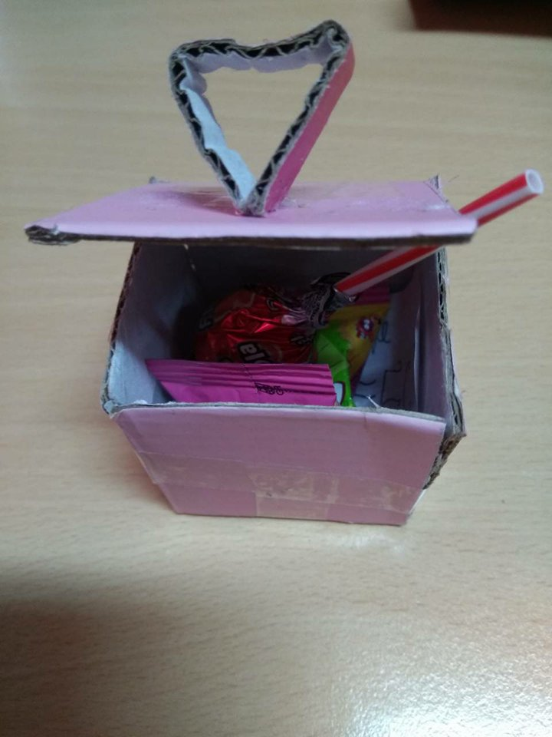
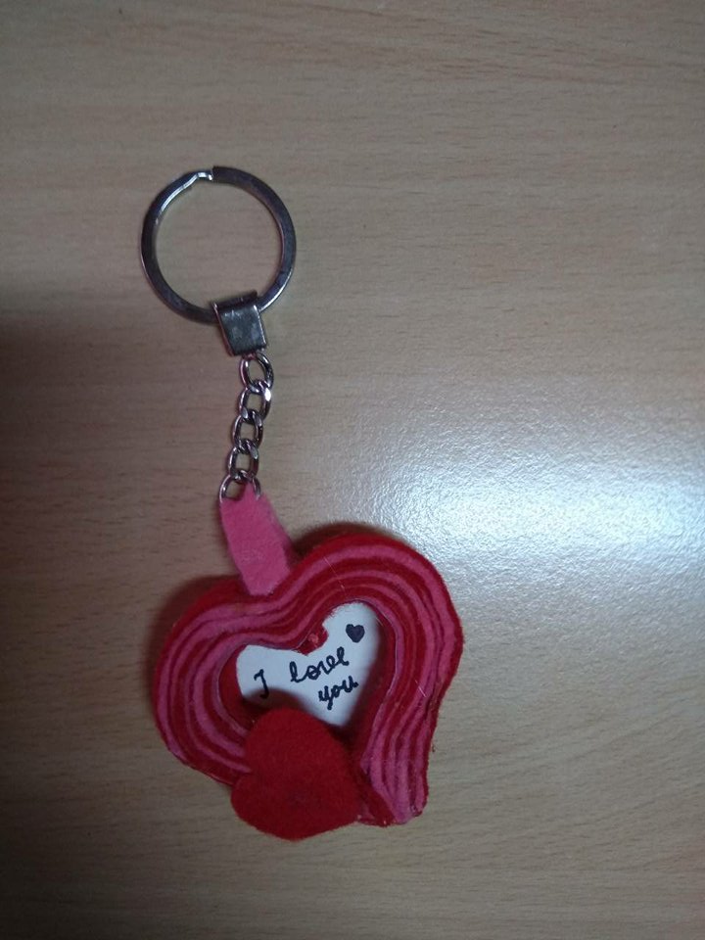
English lesson – presents (Teacher Marijana Matorić and grade 5)

Slide 8
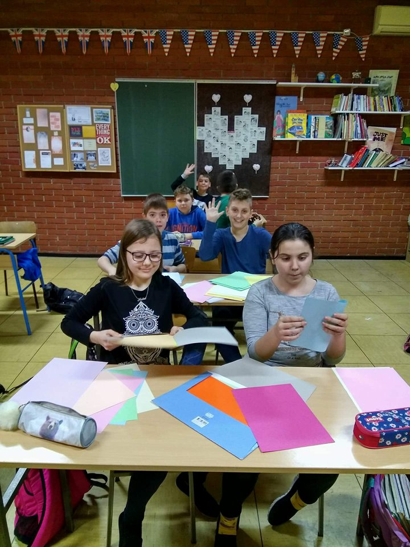
English lesson (Class 5.d – project team)

Slide 9
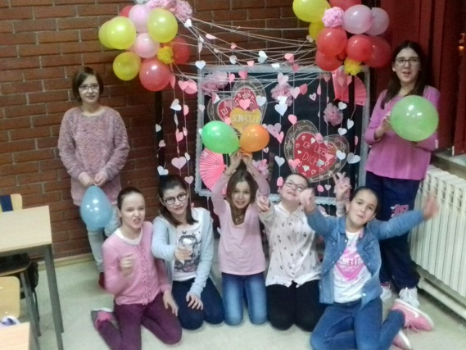
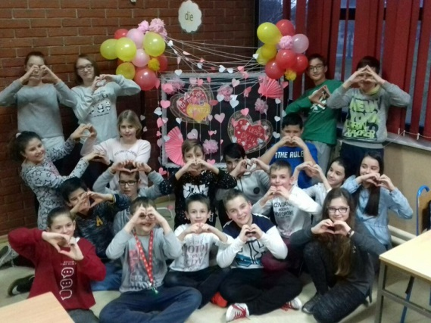
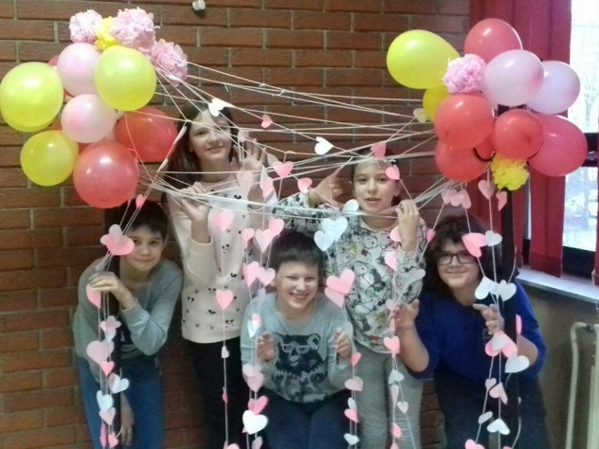
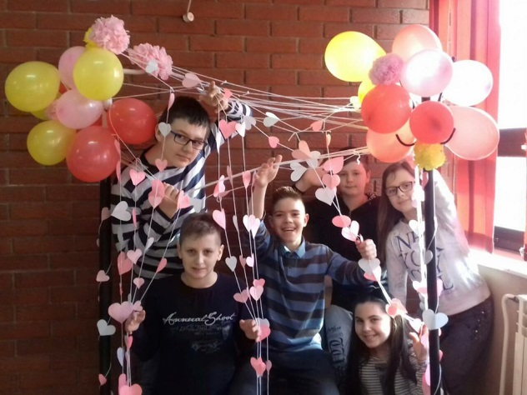
German lesson – students from our project team (Teacher Andrea and grade 5)

Slide 10
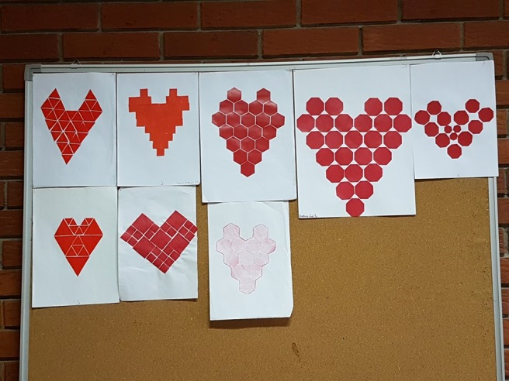
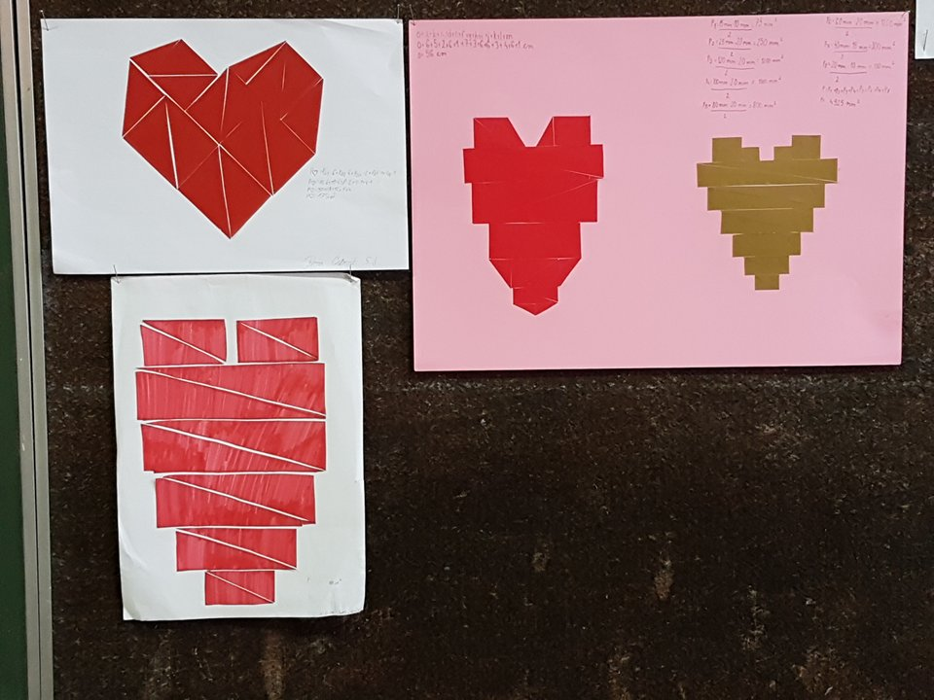
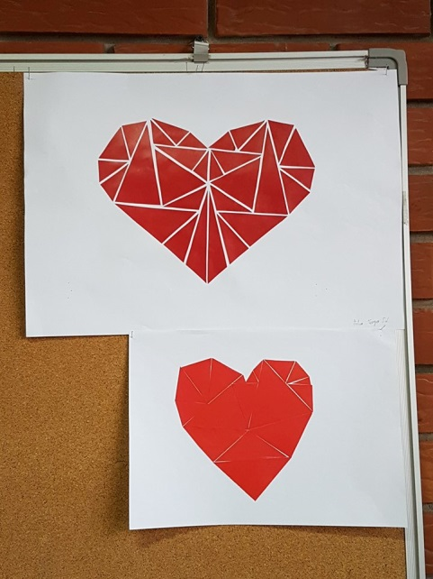
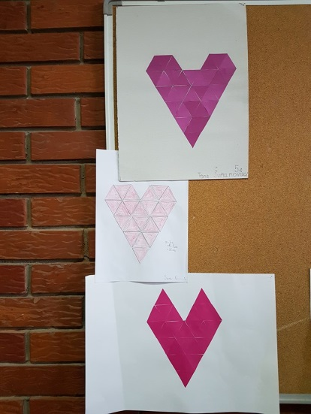
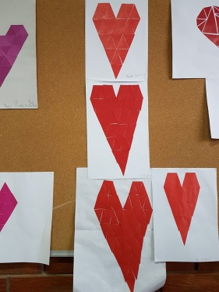
Maths lesson (Teacher Katica Janjić and grades 5&7)

Slide 11
Maths lesson (Teacher Katica and grade 5)
5th grade
Calculating:
the area of a heart and
the perimeter of heart shape
7th grade
the area and perimeter of a polygon

Slide 12
Art lesson (Teacher Zlata Križak Lozić and grade 4)

Slide 13
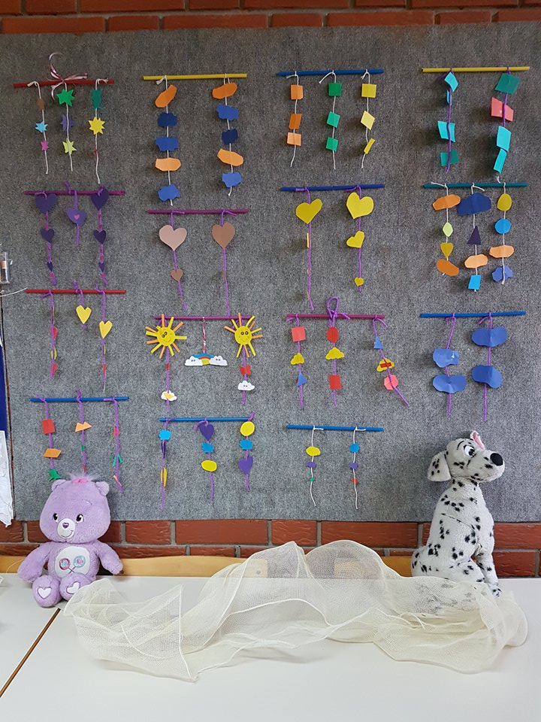
Maths lesson (Teacher Ksenija Bračić and grade 3)

Slide 14
Optional: Creative workshop (Teacher Branka Peulić and grade 3)
Valentine’s cards

Slide 15
Art lesson (Teacher Ivana and grade 1)

Slide 16
Thanks for your attention!

